Slide 1
End-to-end Vision-based Autonomous Driving using Deep Learning
Author
Sergio Paniego Blanco
Supervisor
José María Cañas Plaza
Doctoral Program in Information and Communications Technologies
International Doctoral School
2024
@sergiopaniego
sergio.paniego@urjc.es
https://sergiopaniego.github.io/

Slide 3
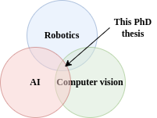
Introduction
Autonomous driving: vehicles that drive safely without human intervention.
Robotics + Artificial Intelligence + Computer Vision + …
Benefits: improved traffic safety and security or more optimized mobility.
The development in the field comes from different sides, specially due to the developments in AI lately.
Motivation: mitigate road traffic accidents (94% of accidents caused by human driver error), reduce driver’s stress, reduce operative costs, reduce pollution…
Some examples from AD companies already suggest an advancement in this direction.

Slide 4
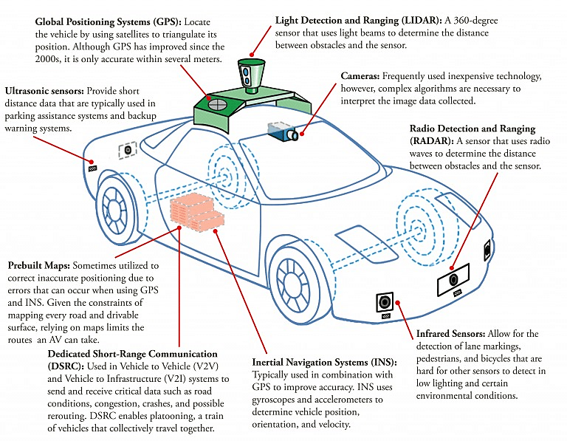
Introduction to AD
Mobile robot in terms of hardware and software.
Sensors like GPS, IMUs, LIDARS, cameras…
Actuators like throttle, brake…
Components supplemented by computational units like CPUs and GPUs.

Slide 5
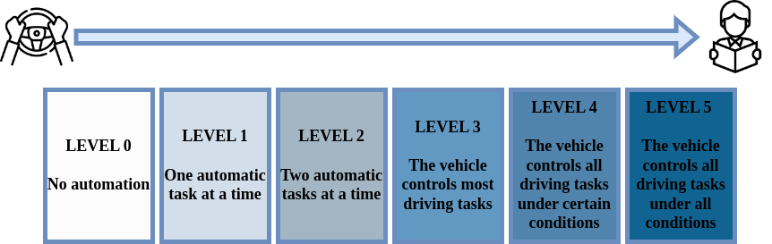
Levels of autonomy
Level 0: Driver only
Level 1: Assisted
Level 2: Partial automation
Level 3: Conditional automation
Level 4: High automation
Level 5: Full automation
Currently on level 4.

Slide 6
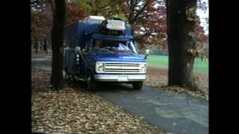
History
First examples in the 80s: Navlab 1, ALVINN…
DARPA Grand Challenge and DARPA Urban Challenge.
Advanced driver-assistance systems (ADAS).

Slide 7
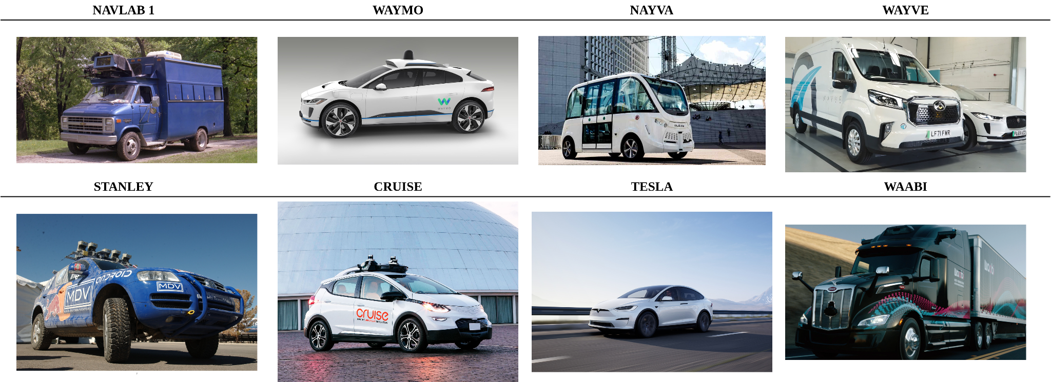
Range of application
Diverse range of environments and weather conditions.
Urban scenarios, roads, highways.
Vast range of vehicle types.
Nav2 for navigation in robotics.

Slide 8
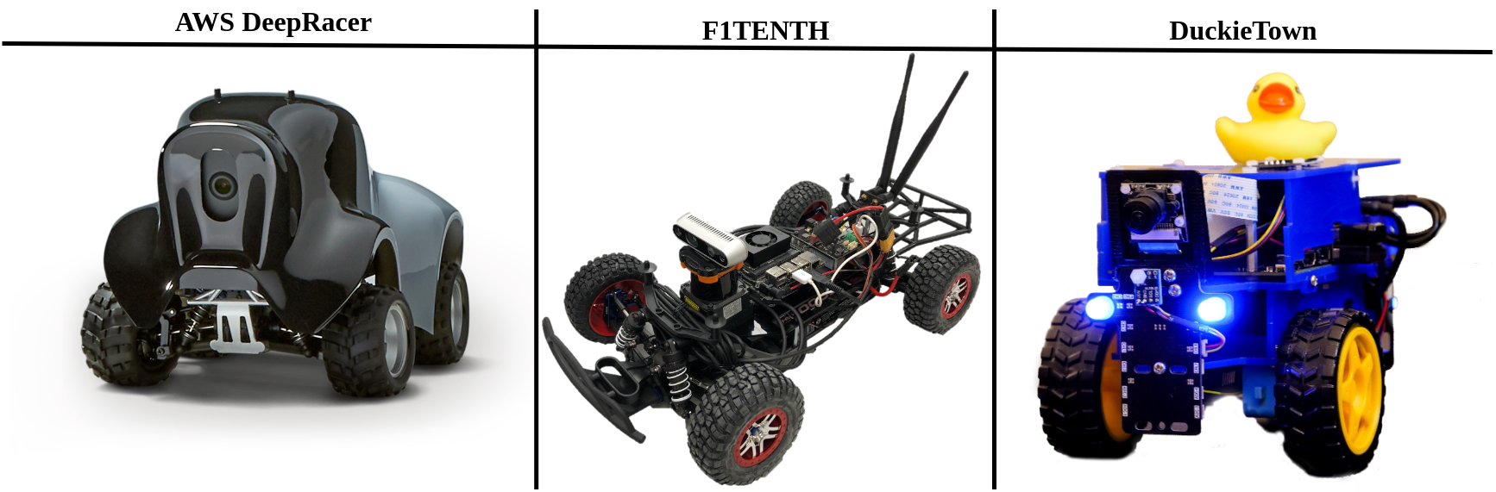
Growing research community
Incremental importance.
Many workshops, tutorials in conferences.
Competitions.

Slide 9
Assessment and metrics
Deep learning includes a broad spectrum of methodologies aimed at evaluating solutions derived from research.
The rigorous assessment of the behavior assumes critical significance in elucidating the inherent strengths and vulnerabilities.

Slide 10
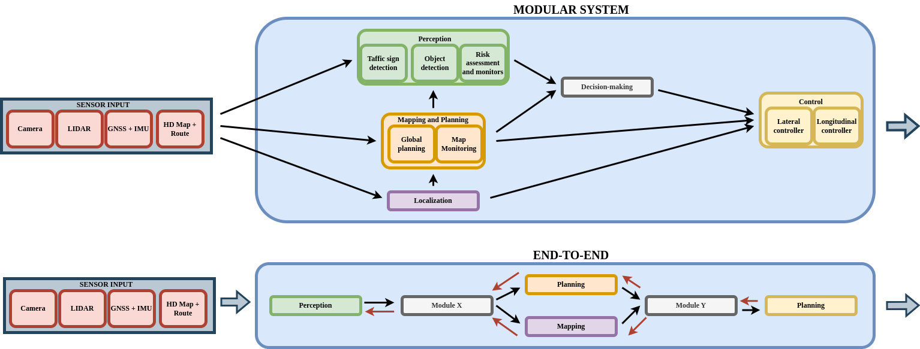
End-to-end and modular approaches
2 main approaches in the development of AD solutions:
Modular.
End-to-end (E2E).
The majority are currently modular but there is a trend towards end-to-end.

Slide 11
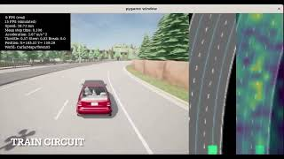
Tasks in an AD system
A multitude of driving tasks are combined into the final AD system
Autonomous parking, lane following, intersection negotiation…

Slide 12
Optimization in AD solutions
In robotics and AD, we need solutions that are fast and reliable.
The performance not only depend on the quality of the decisions but also on their frequency.
Some AD vehicles and robots are equipped with high-performance hardware but there are systems where this is not true.
Solutions must be optimized while upholding stringent safety standards.

Slide 13
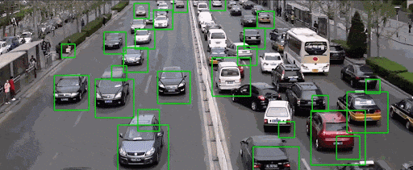
Traffic monitoring using CV
Traffic monitoring plays a pivotal role in urban planning transportation managements, and public safety.

Slide 14
Research goals
A systematic study of the state-of-the-art in AD.
Validate computer vision in a driving setting generating a traffic monitoring tool.
Generate an object detection assessment software to validate solutions (Detection Metrics).
Generate an autonomous driving behaviors assessment software to conduct the experiments and generate quantitative data.
Empirical study of the improvements to the basic visual lane following with the addition of visual memory and kinematic input.
Empirical study of model optimization for the controllers of AD vehicles, generating optimized models that improve the system.
Generation of and E2E shallow model capable of driving in traffic based on visual input.

Slide 16
Traffic monitoring
Traffic monitoring is a classic problem within computer vision.
Before deep learning, traffic surveillance using video cameras was significantly limited but this changed with the appearance of this technology.

Slide 17



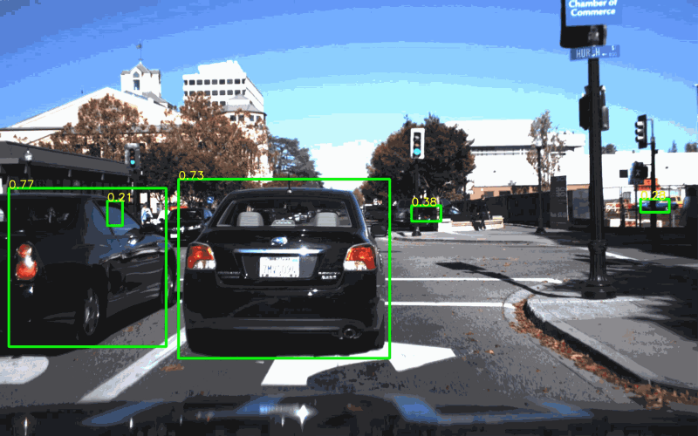
Deep learning object detection, datasets and assessment
Significant popularity lately. Notable advancements.
Part of the perception in autonomous driving systems.
Many datasets are available like COCO, ImageNet, Pascal VOC… and some others specialized.
Each CV tasks includes a specific set of evaluation metrics.
All the current state-of-the art solutions rely on DL.
In object detection, we find examples like Faster R-CNN, SSD, YOLO, DETR, Swin Transformer, DINO…

Slide 18
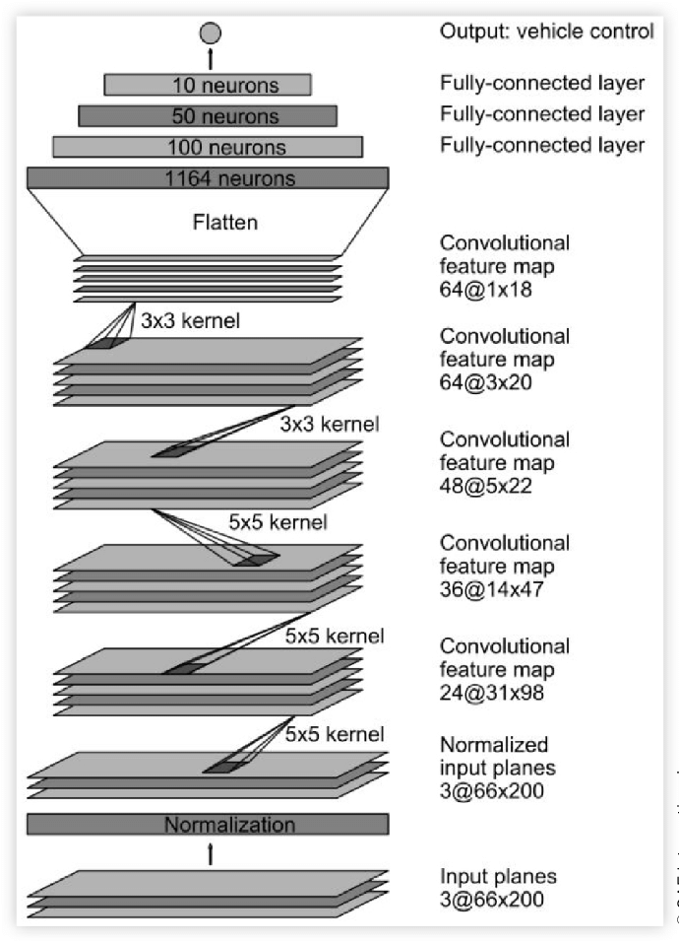
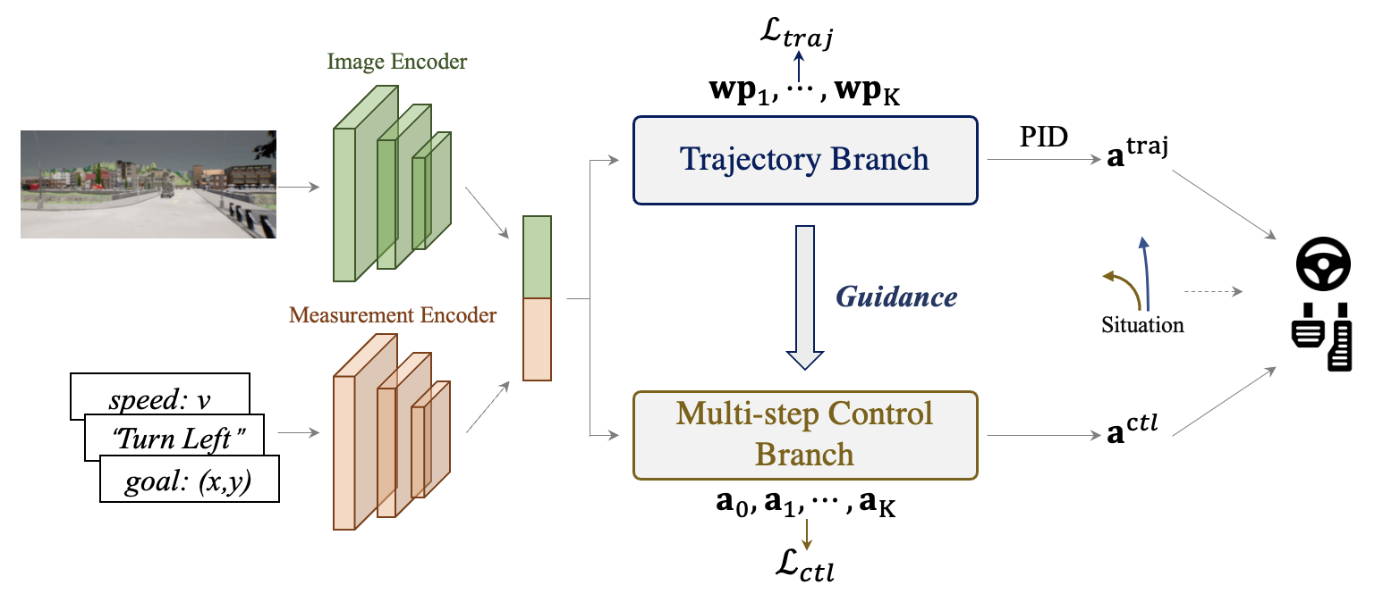
Autonomous driving and imitation learning
AD combines artificial intelligence, robotics, and CV.
Modular vs E2E approach.
Vision-based E2E AD.
PilotNet.
TCP, ReasonNet, NET, Transfuser…

Slide 19
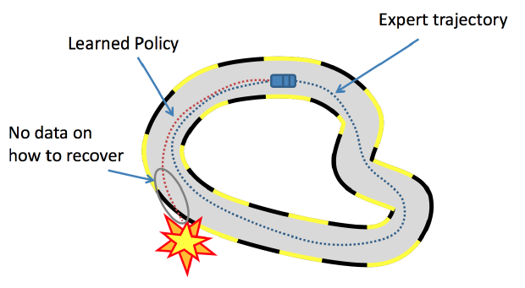
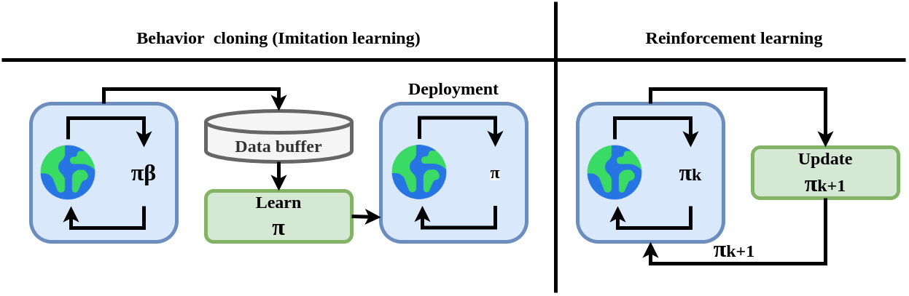
Imitation learning and RL for driving autonomously
Imitation learning (behavior cloning): generating a driving policy learning from expert agent-gathered data.
RL.
Combination of both.

Slide 20
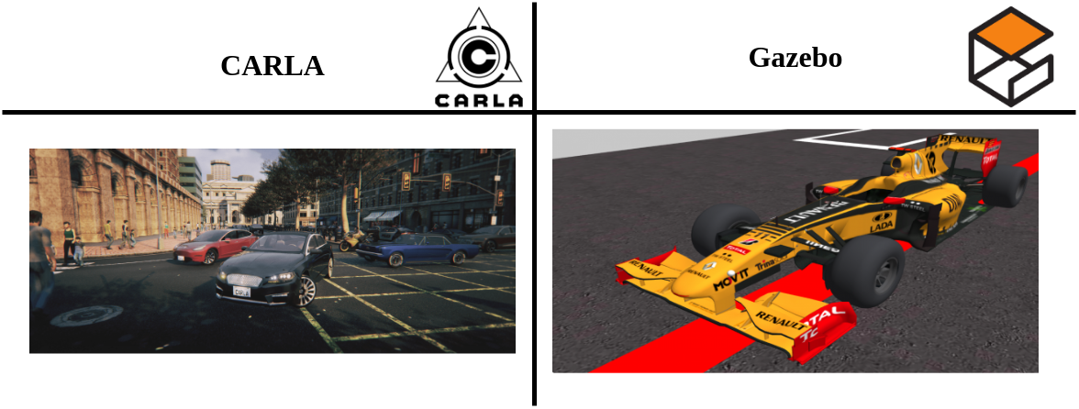
Simulation in AD and assessment. Datasets
In the development and research of robotics systems, simulators are commonly used to generate solutions rather than directly developing in real robotics or vehicles.
A diverse array of simulators for AD are available. SUMO, TORCS, Gazebo , CARLA, DeepDrive, Autoware, proprietary simulators…

Slide 21
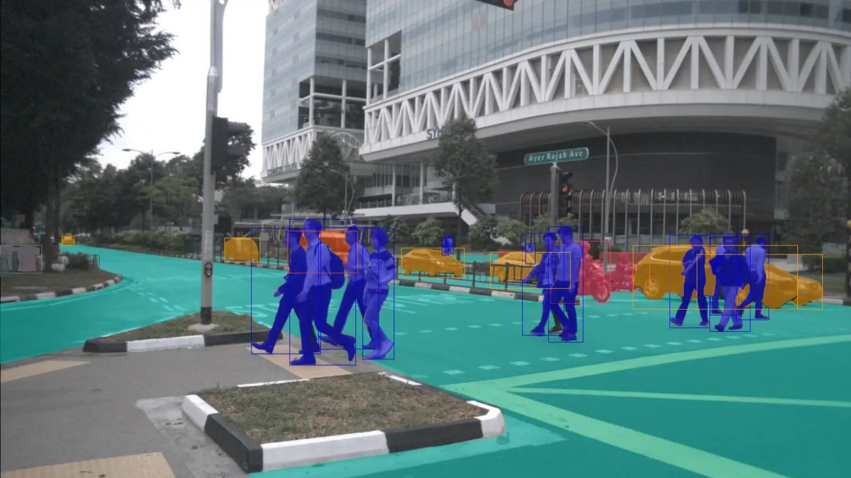
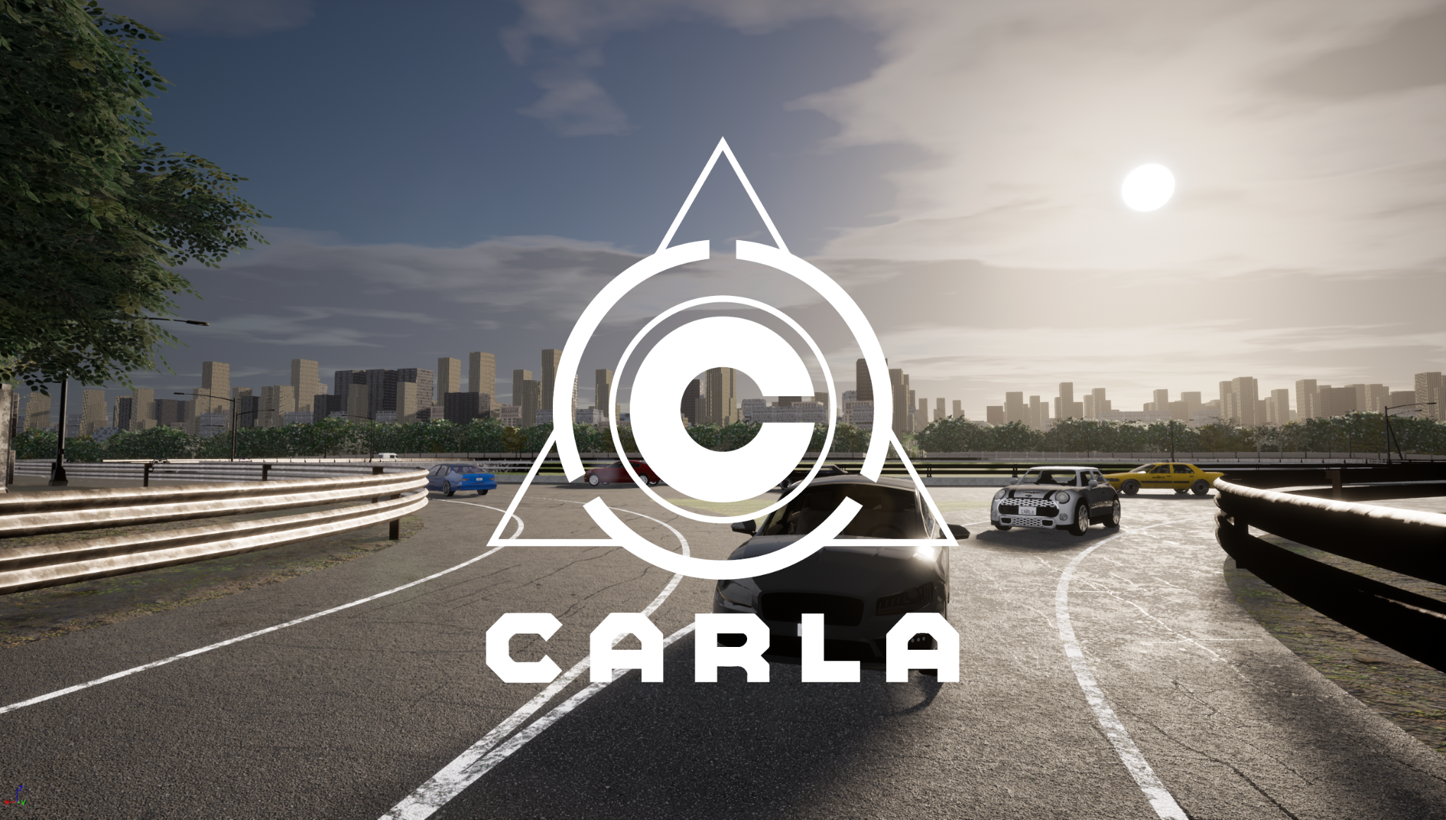
Simulation in AD and assessment. Datasets
In AD development, there are a lot of specialized datasets: nuScenes, BDD100K, KITTI, Cityscapes…
CARLA Leaderboard for the assessment of solutions.
Many different tasks and specific metrics needed.

Slide 22
Memory-based approaches in E2E visual AD
An intriguing avenue of research within the E2E approach involves integrating memory capabilities.
LSTM modules, convLSTMS…

Slide 23
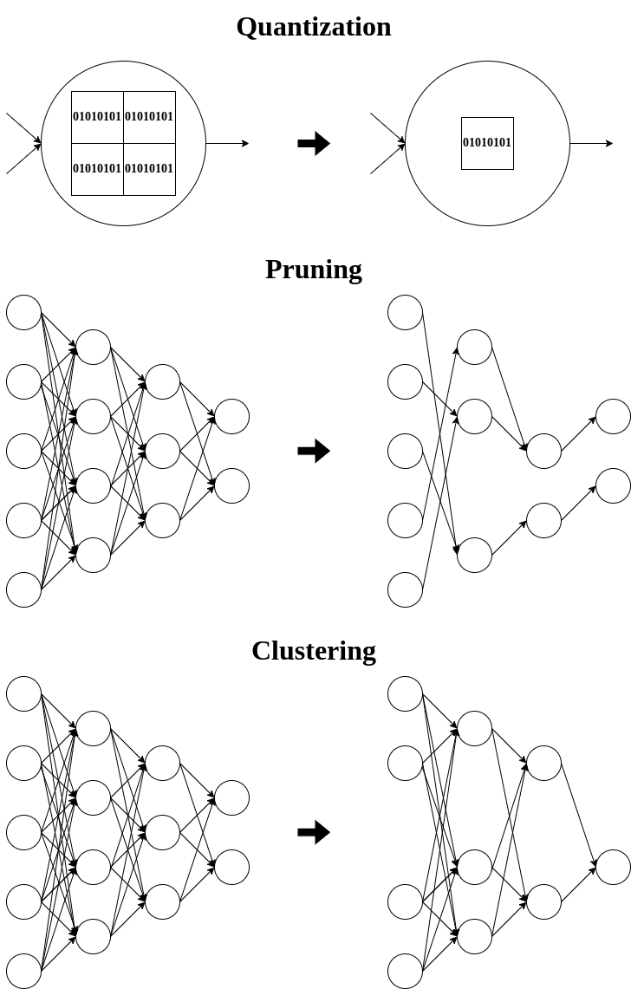
Optimization of deep learning models for autonomous driving
The optimization of deep learning models is key, as previously discussed.
There are an extensive number of optimization techniques:
Quantization
Pruning
Fine-tuning (re-training) with optimization aware techniques
Clustering.
PyTorch or Tensorflow already include support.
TensorRT for Nvidia GPUs.

Slide 25
Monitoring and assessing traffic with deep learning
Monitoring of real-time traffic on highways, road, and streets may provide useful data both for infrastructure planning and for traffic management in general.
TrafficSensor: open-source system that employs deep learning for automatic vehicle tracking and classification on highways using a calibrated and fixed camera.
J. Fernández, J. M. Cañas, V. Fernández, and S. Paniego, “Robust real-time traffic surveillance with deep learning,” Computational Intelligence and Neuroscience, vol. 2021, p. 4 632 353, Dec. 2021. doi: 10.1155/2021/4632353. [Online]. Available: https://doi.org/10.1155/2021/4632353

Slide 26
Monitoring and assessing traffic with deep learning
A new dataset was created.
The system has two modules: one for vehicle detection and classification and the other for vehicle tracking.
The first module uses YOLOv3 and YOLOv4.
The second module combines a simple spatial association algorithm with more sophisticated KLT tracker to follow the vehicles.
Several experiments validated the system.
The software is available open-source for replicability and extension.

Slide 27
Introduction
DL techniques has made advancements much easier in monitoring of vehicle transport.
Sophisticated systems capable of detecting vehicles in both routine and challenging scenarios have become feasible.
Building upon this advancements, we have built TrafficSensor, a vision-based traffic monitoring project. It is an evolution of a previous system (TrafficMonitor), achieving higher reliability and performance even in challenging lighting or weather conditions and with poor camera resolution, all in real-time.

Slide 28
TrafficSensor: a deep learning-based traffic monitoring tool
TraficSensor is a software tool for real-time traffic monitoring, capable of classifying vehicles into seven categories: motorcycles, cars, vans, buses, trucks, small trucks, and tank trucks.
3 main blocks: vehicle detection, vehicle classification and vehicle tracking.
2 modules: detection and classification and vehicle tracking.

Slide 29
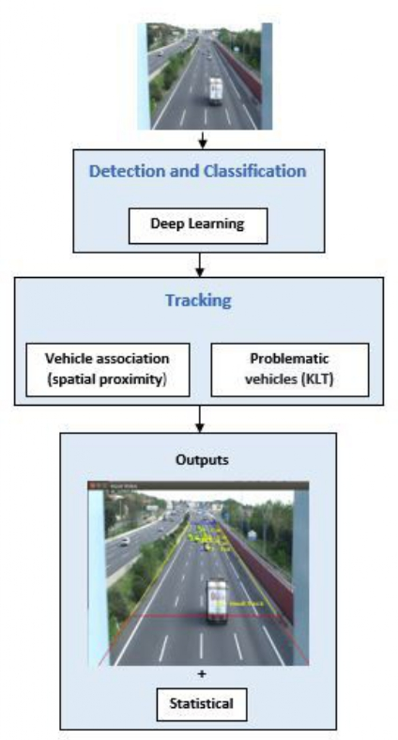
TrafficSensor: a deep learning-based traffic monitoring tool

Slide 30
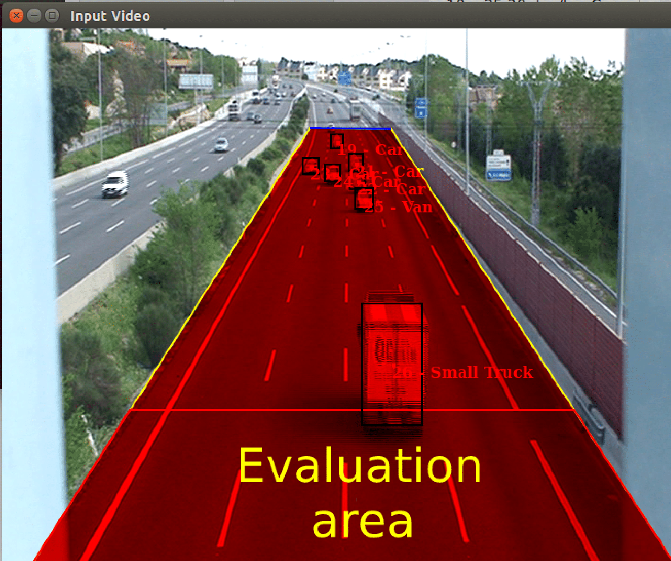
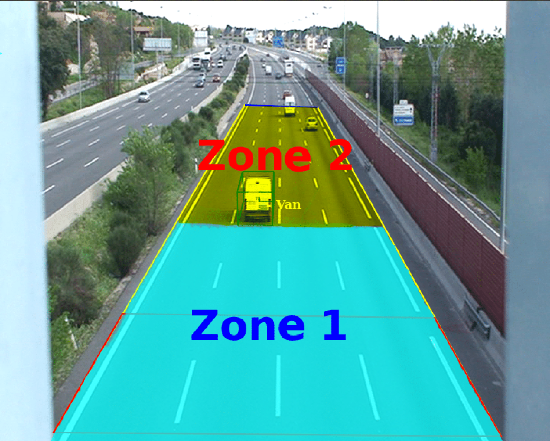
TrafficSensor: a deep learning-based traffic monitoring tool
Evaluation area
Evaluation zone

Slide 31
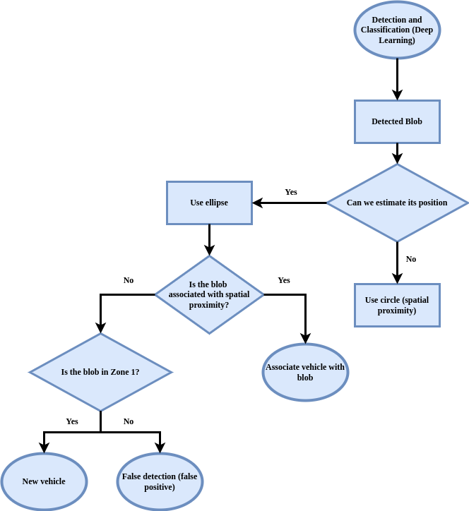
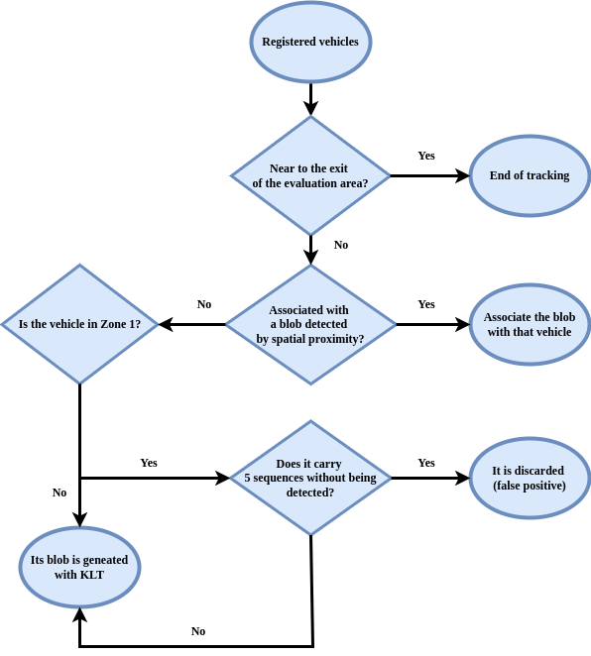
TrafficSensor: a deep learning-based traffic monitoring tool
Execution flow chart of detected blobs
Flow chart of registered vehicles

Slide 32
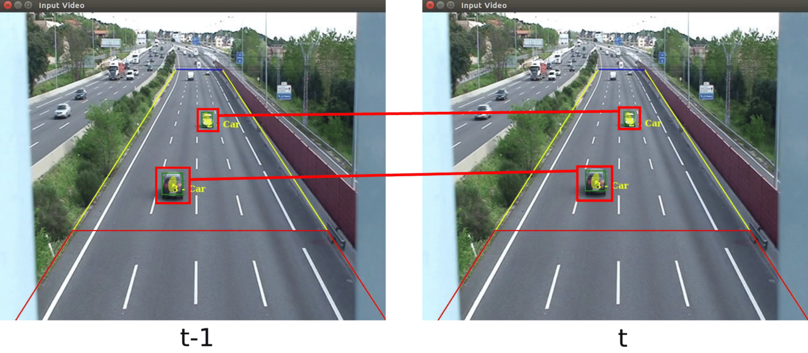
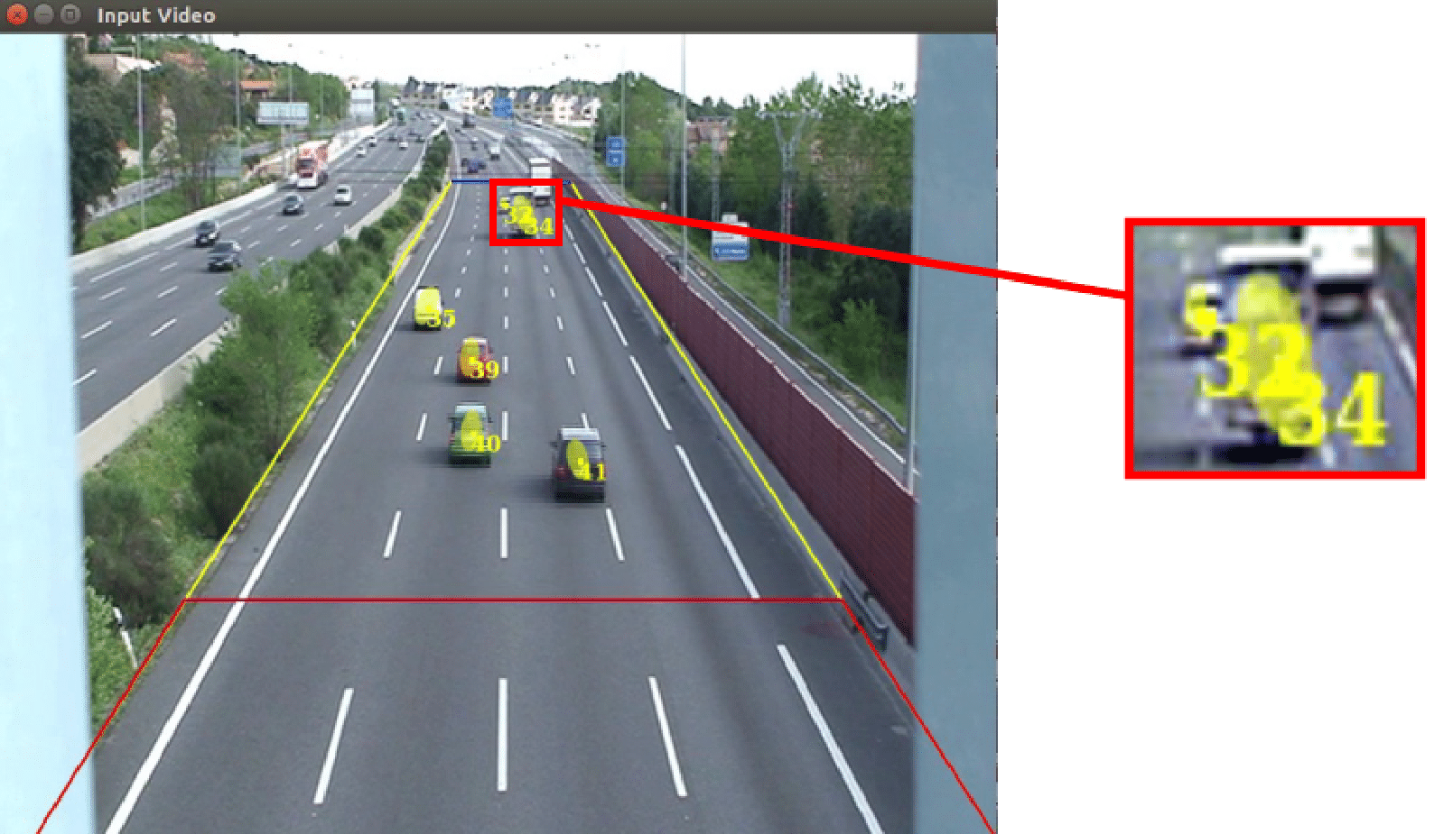
TrafficSensor: a deep learning-based traffic monitoring tool

Slide 33
Experimental evaluation
The proposed system is validated with a dataset of real traffic images.
Detection Metrics for comparing different deep learning models in object detection (my contribution).
The dataset includes images in good weather conditions, images in bad weather conditions and poor-quality images (~10000 examples).

Slide 34
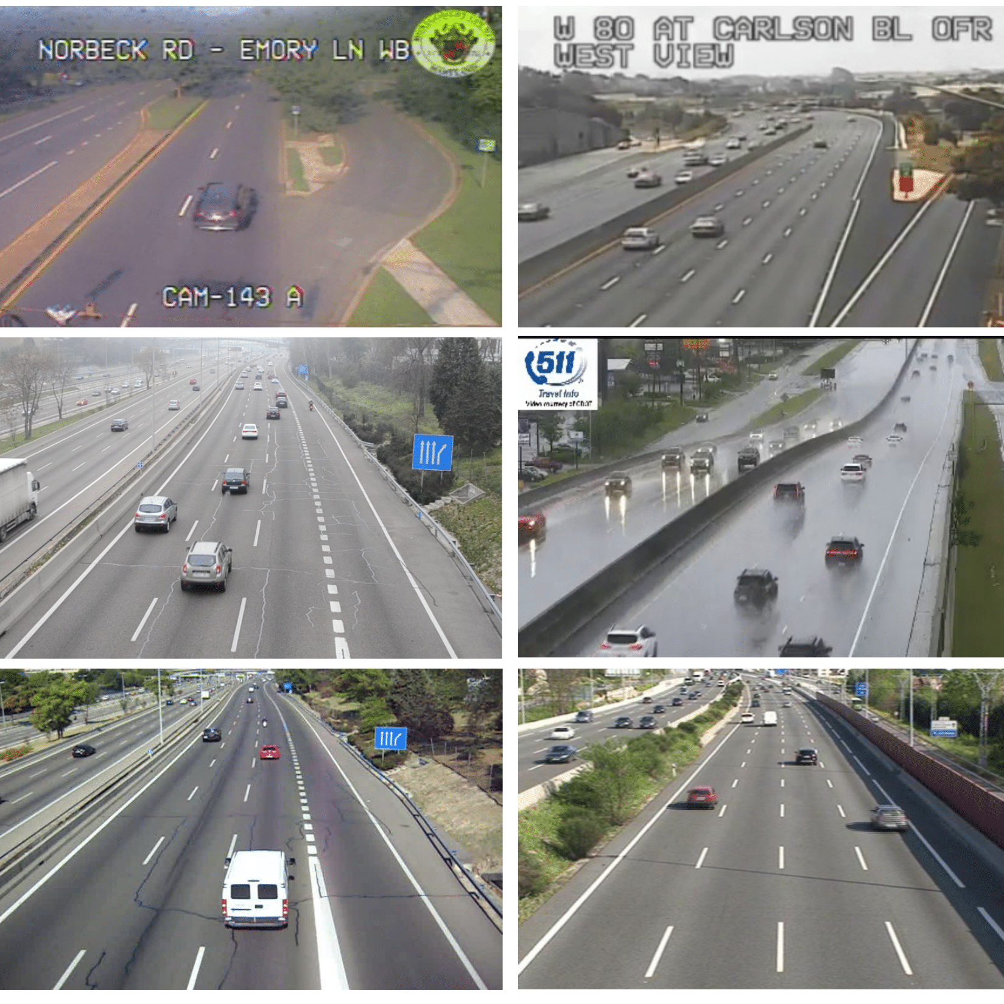
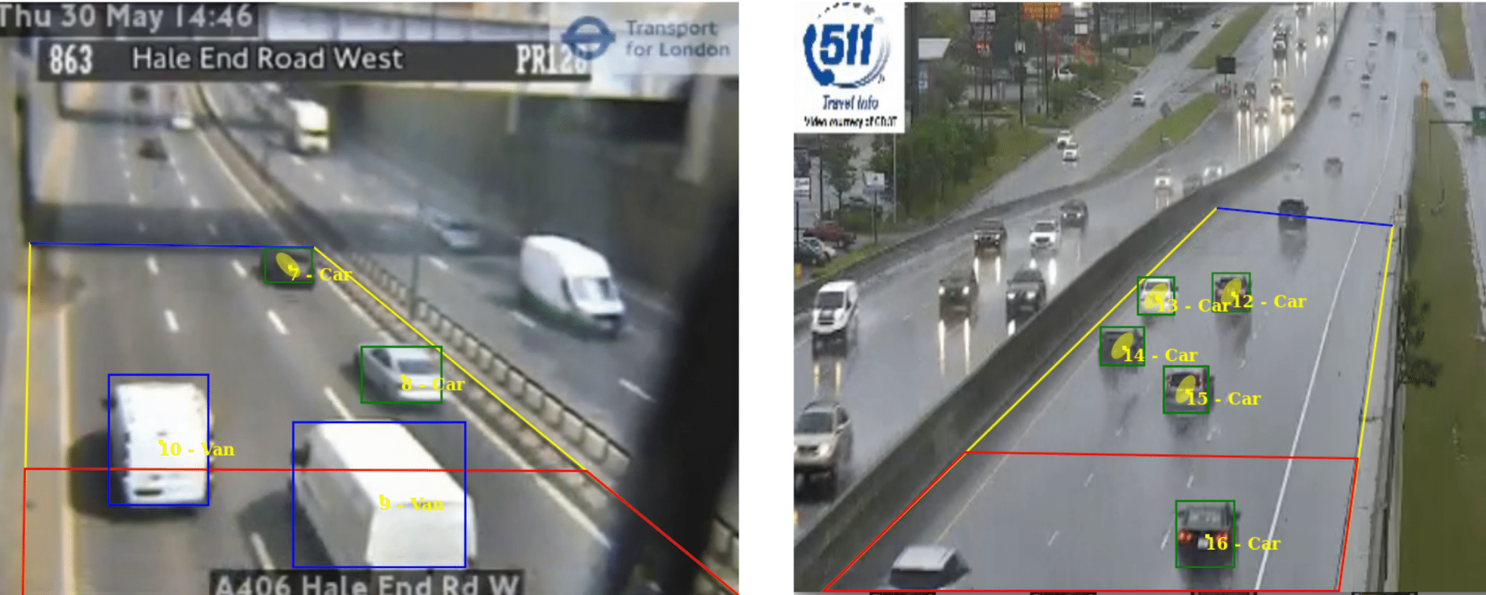
Experimental evaluation

Slide 35
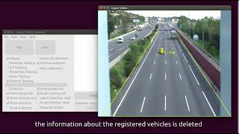
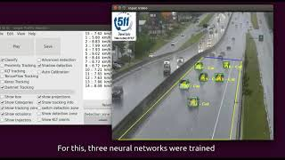
Experimental evaluation

Slide 36
Conclusions
TrafficSensor is a solution for vehicle surveillance using deep learning. It distinguishes between 7 classes.
Different DL models were studied and tested.
A new dataset was curated for this application.
The application proves to be robust to bad weather conditions, and blurred or low-res traffic images.
Since the inception and publication of this contribution, notable advancements have emerged within the state-of-the-art. For example, new YOLO improvements (YOLOv5, v9, v10…) or transformer-based architectures (DETR, Swin Transformer, DINO…).

Slide 38
Assessing object detection deep learning architectures with quantitative metrics
In the previous contribution, we explored the monitoring of traffic using state-of-the-art computer vision techniques. For that contribution, we developed a comparison tool that was used during the research process for the objective assessment of object detection approached that we were exploring.
This comparison tool is Detection Metrics.
Open-source tool.
S. Paniego, V. Sharma, and J. M. Cañas, “Open source assessment of deep learning visual object detection,” Sensors, vol. 22, no. 12, 2022. doi: 10.3390/s22124575. [Online]. Available: https://www.mdpi.com/1424-8220/22/12/4575

Slide 39
Introduction
This assessment tool has been developed to provide objective performance metrics, allowing researchers to systematically evaluate different DL models for object detection on large datasets and determine the most effective approach for specific use cases.
It has a broad range of applicability, from traffic monitoring to the perception module of an autonomous driving system.
It comprises a suite of tools with unique features to facilitate the objective comparison of different DL models for object detection.

Slide 40
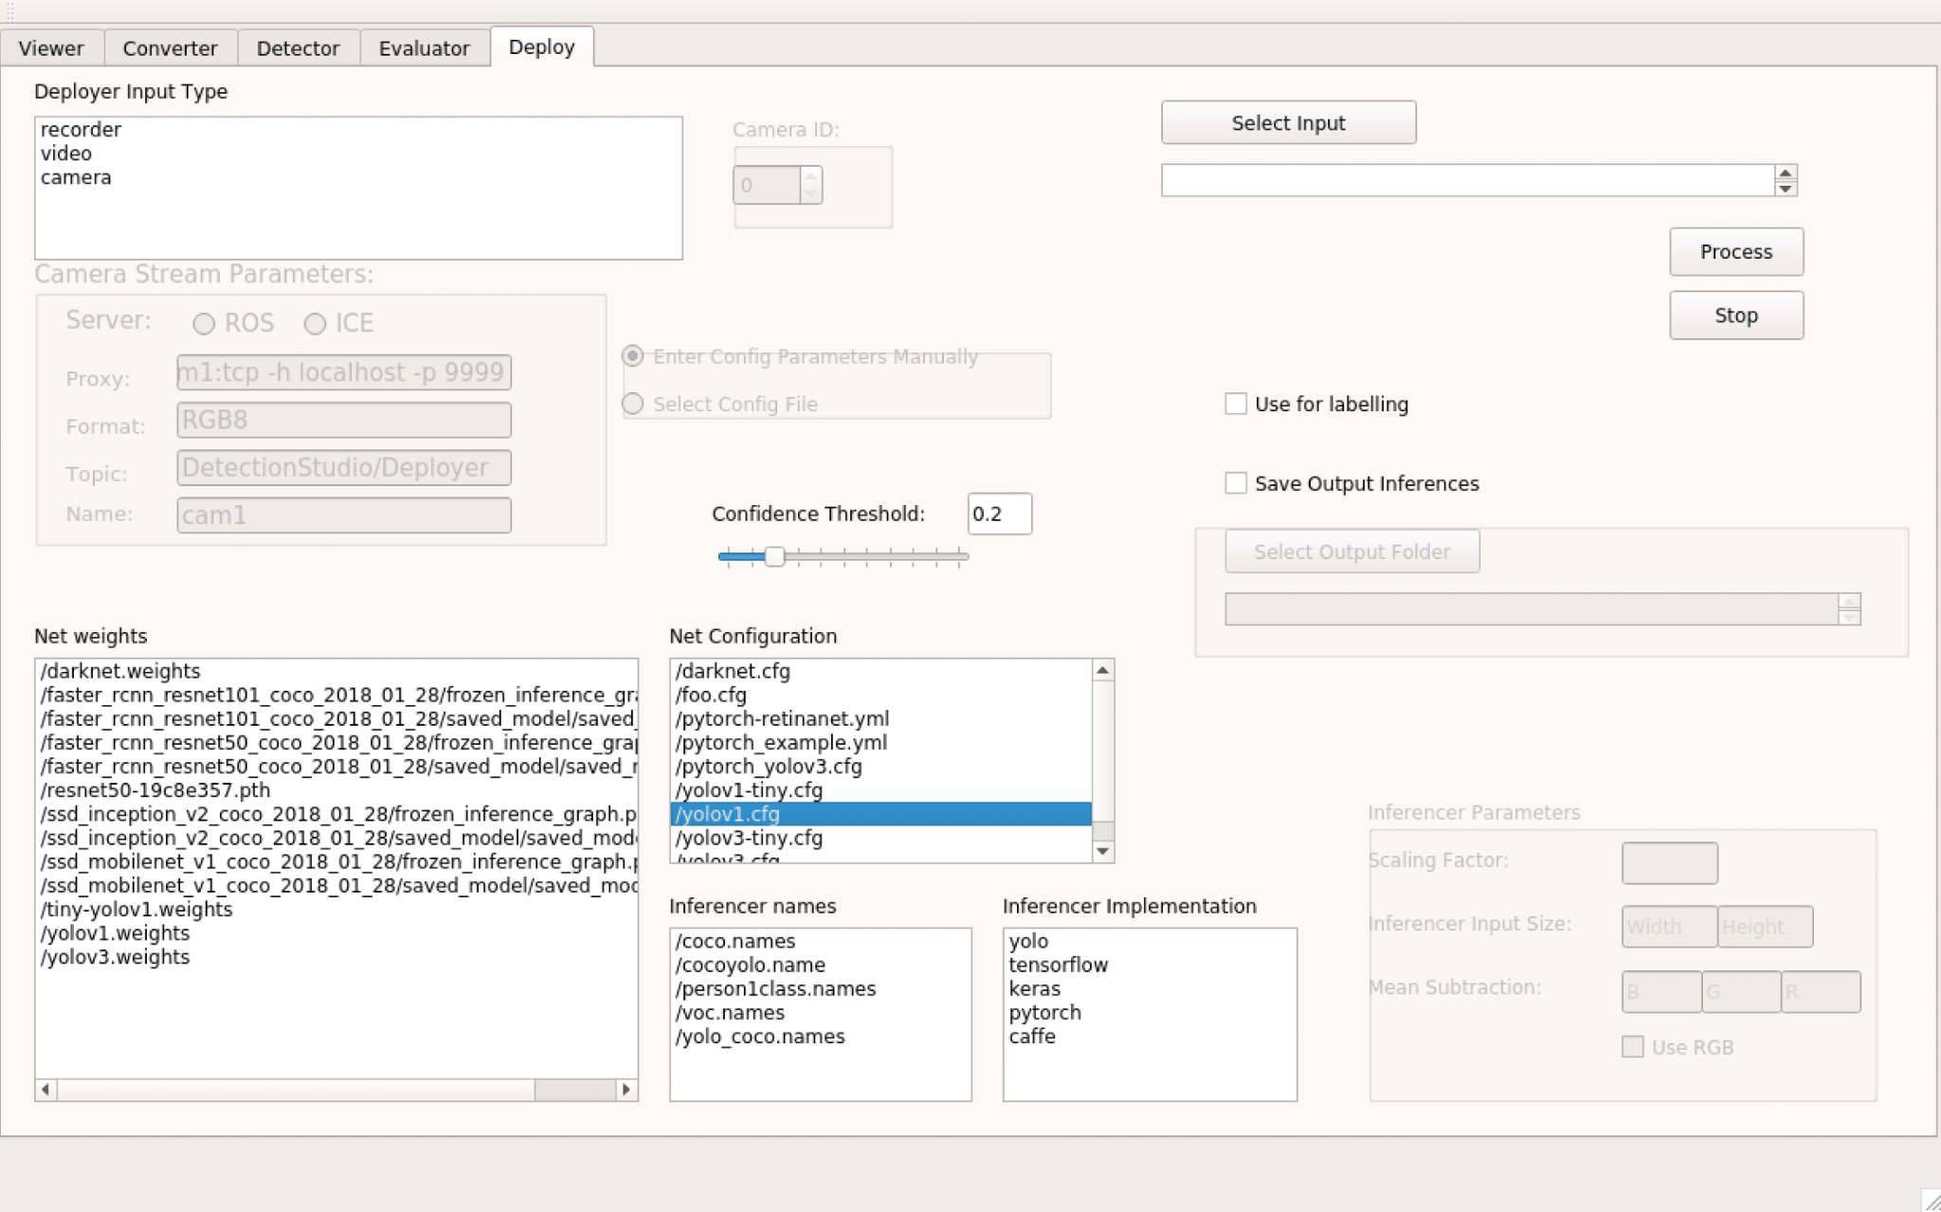



Detection Metrics tool kit
The application supports the main DL frameworks, along with the principal datasets for object detection.
It can be used as a ROS Node.
Two workflows:
Headless
Graphical.
Detection generation.
Evaluation of detections with objective metrics.
Live detection visualization.
Dataset converter

Slide 41
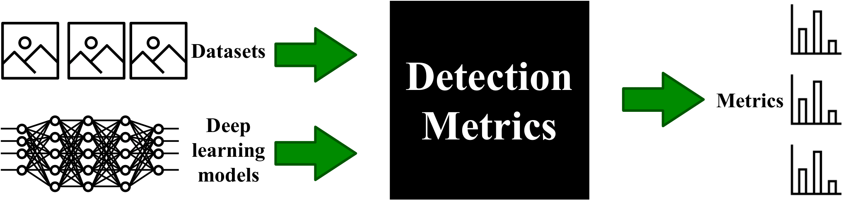
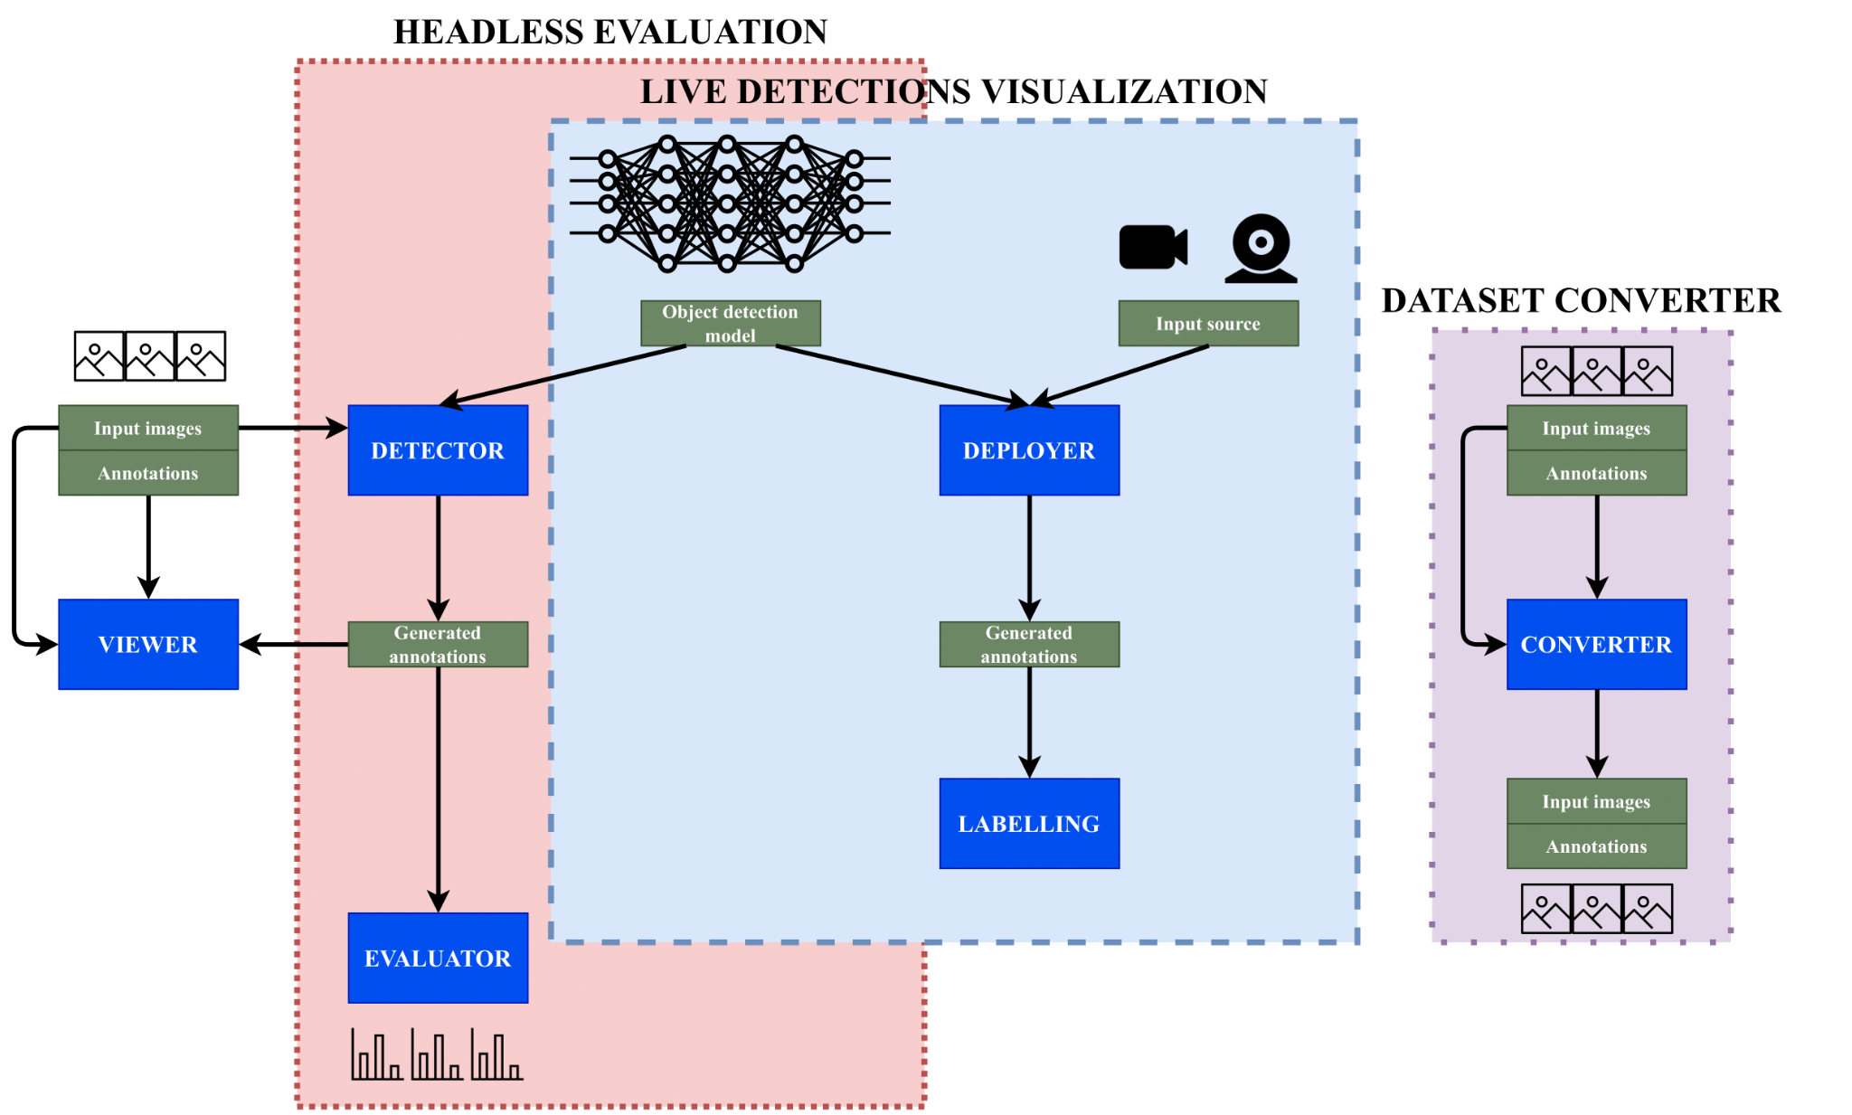
Detection Metrics tool kit

Slide 42
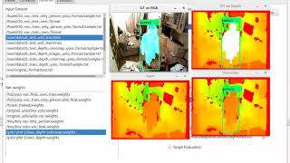
Detection Metrics tool kit

Slide 43
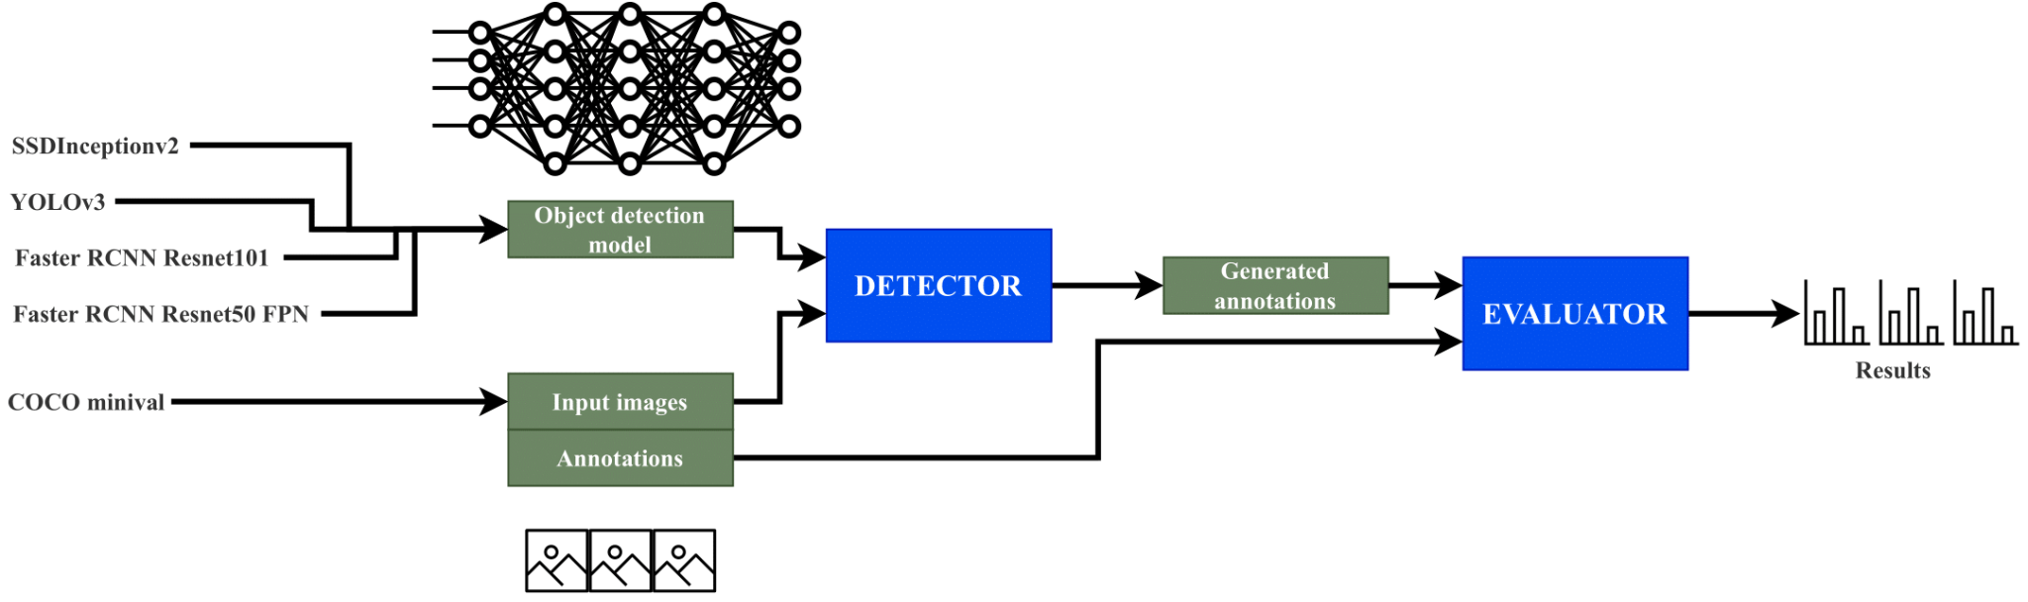
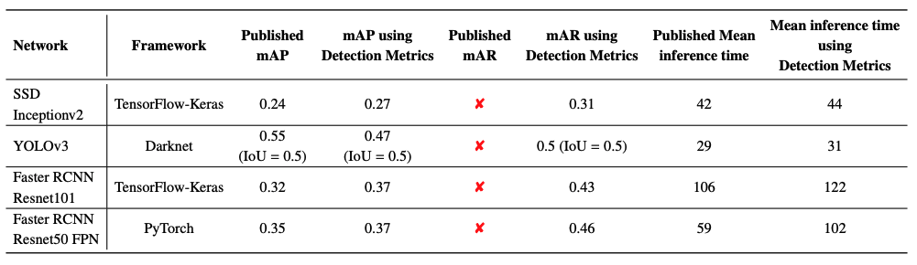
Experimental results and discussion
Used in TrafficSensor.
Comparison of state-of-the-art detection networks.

Slide 44
Conclusions
Open source assessment tool validated in several experiments.
Since the development of this contributions and its publication, new contributions have appeared that are relevant for the state-of-the-art. For example YOLOv5, v9… or the developments that use transformer-based architectures (DETR, DINO…)

Slide 46
Assessing autonomous driving behaviors fine-grained metrics
Behavior Metrics is a software tool developed to help research in the autonomous driving field.
The development and validation of autonomous driving solutions require testing broadly in simulation.
Addressing this requirement, we present Behavior Metrics for the quantitative and qualitative assessment and comparison of solutions for the main autonomous driving tasks.
S. Paniego, R. Calvo-Palomino, and J. Cañas, "Behavior Metrics: An Open-Source Assessment Tool for Autonomous Driving Tasks," Software X, vol. 26, pp. 101702, 2024 doi: 10.1016/j.softx.2024.101702. [Online]. Available: https://doi.org/10.1016/j.softx.2024.101702

Slide 47



Assessing autonomous driving behaviors fine-grained metrics
Two main evaluation pipelines: graphical and headless.
Generates quantitative metrics complementary to the simulator’s, including fine-grained metrics for each particular driving task (lane following, driving in traffic, route navigation…)
It uses and supports Carla, ROS, PyTorch and Tensorflow.
It is available open-source for the community.

Slide 48
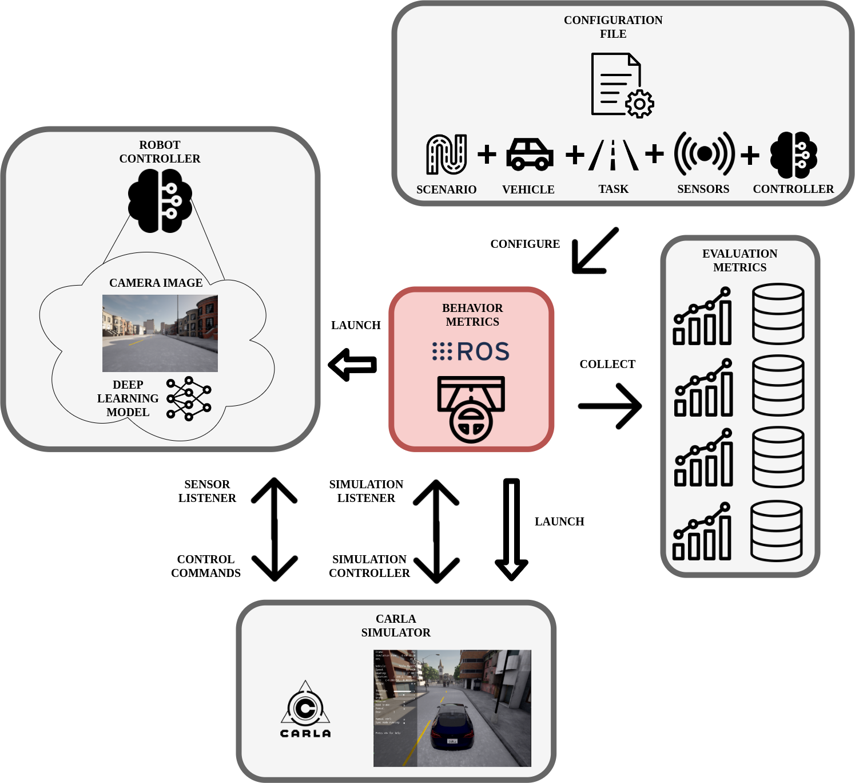
Assessing autonomous driving behaviors fine-grained metrics

Slide 49
Introduction
We need reliable and secure AD solutions.
Behavior Metrics is a multi-platform open-source software for the assessment of autonomous driving solutions in simulation for different driving tasks.

Slide 50
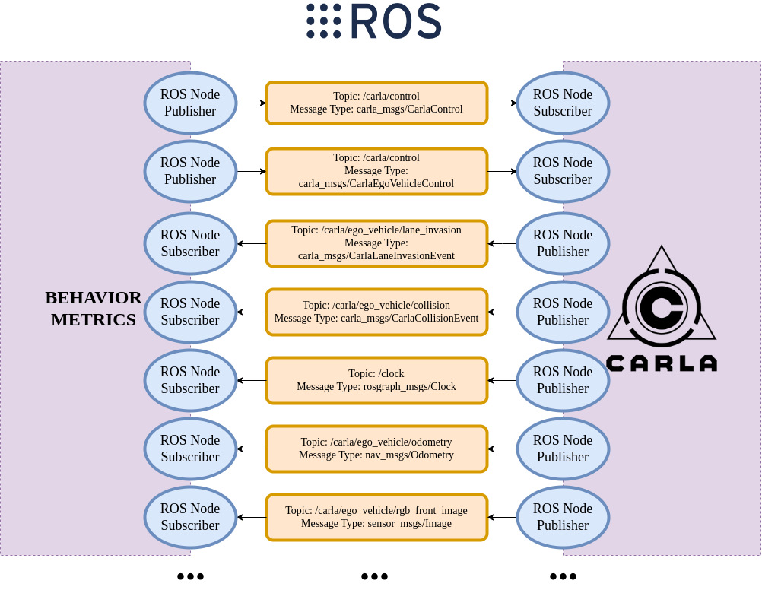
Connection between BM and CARLA

Slide 51
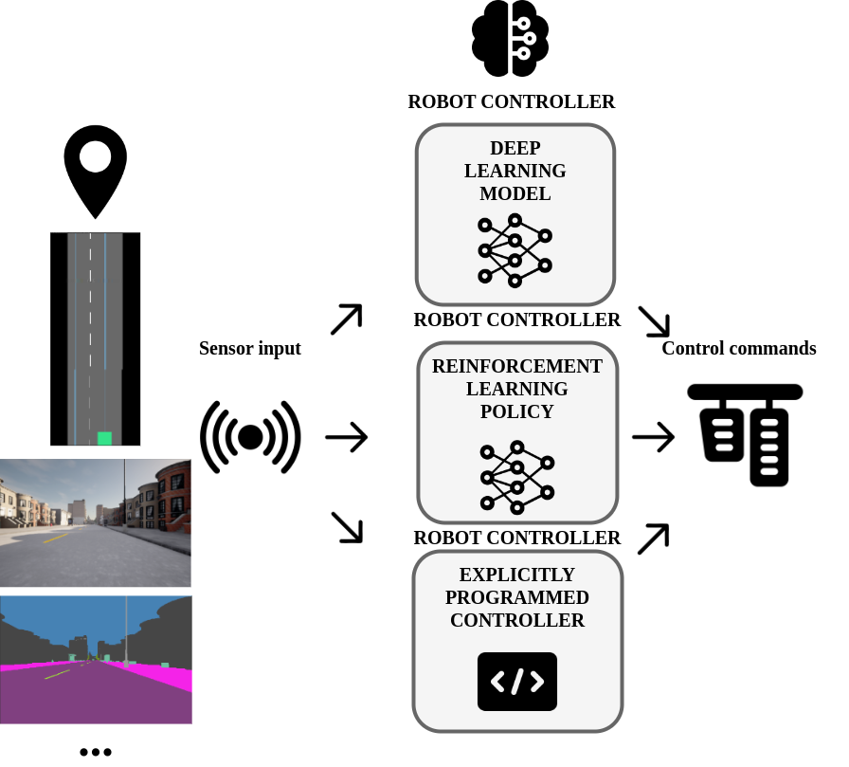
Robot controller

Slide 52
Supported tasks
It currently supports three main tasks:
Lane following
Driving in traffic
Point-to-point navigation

Slide 53
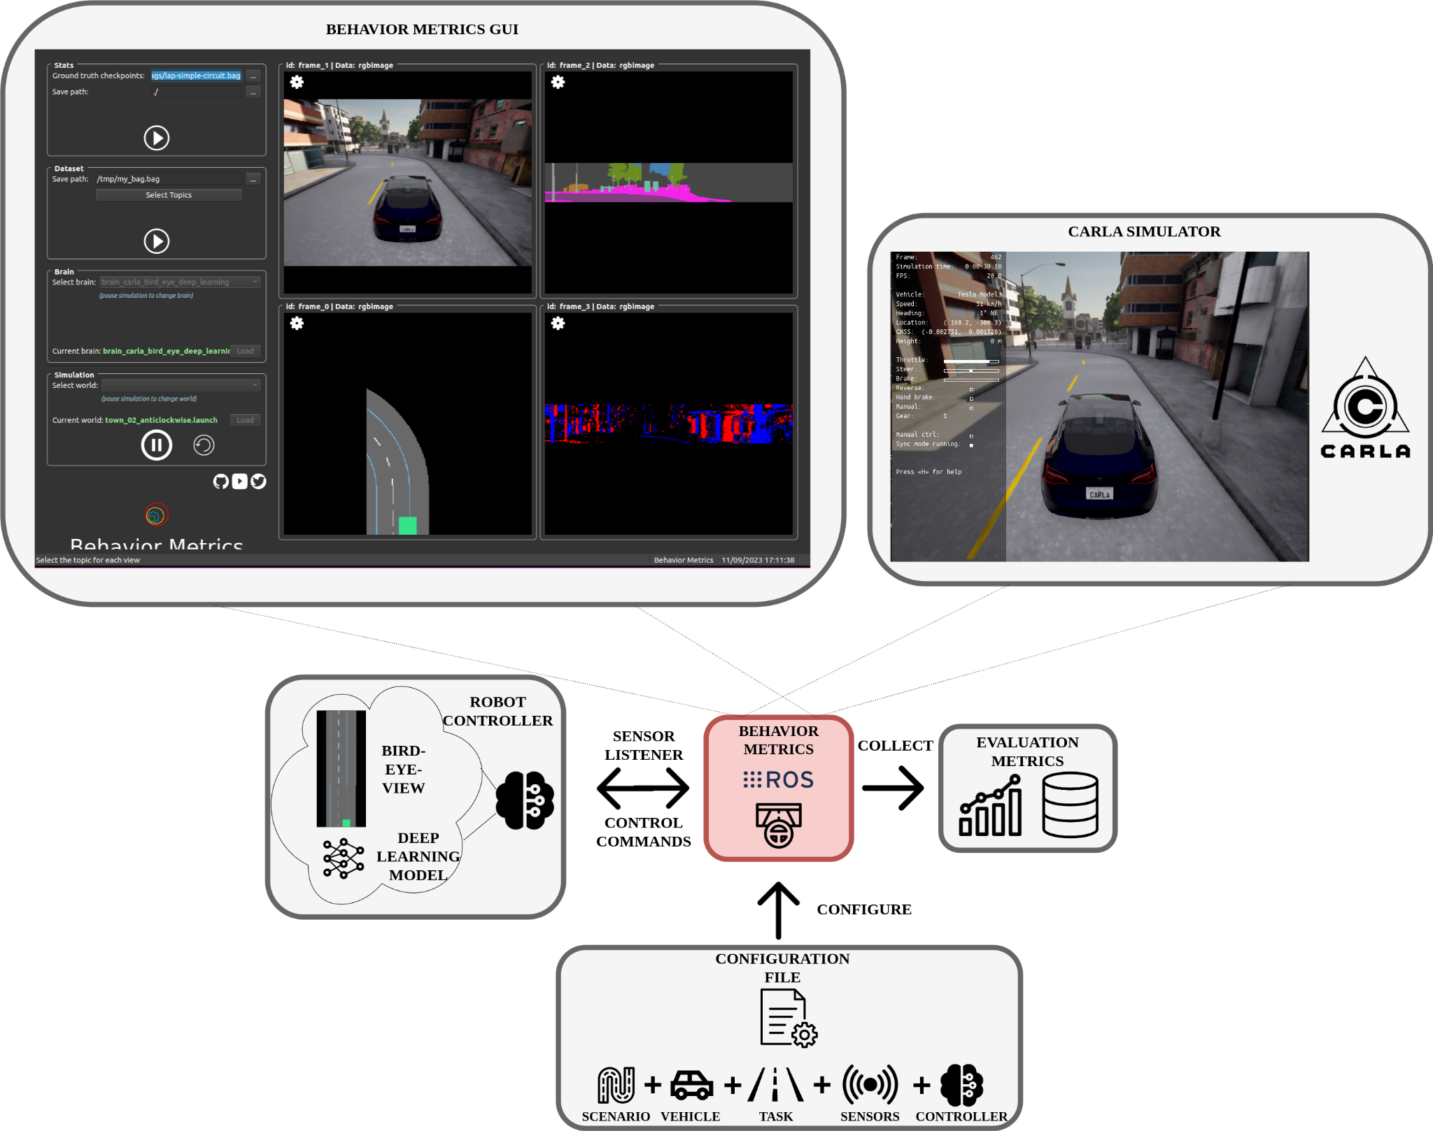
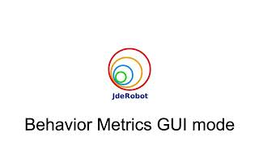
GUI evaluation mode

Slide 54
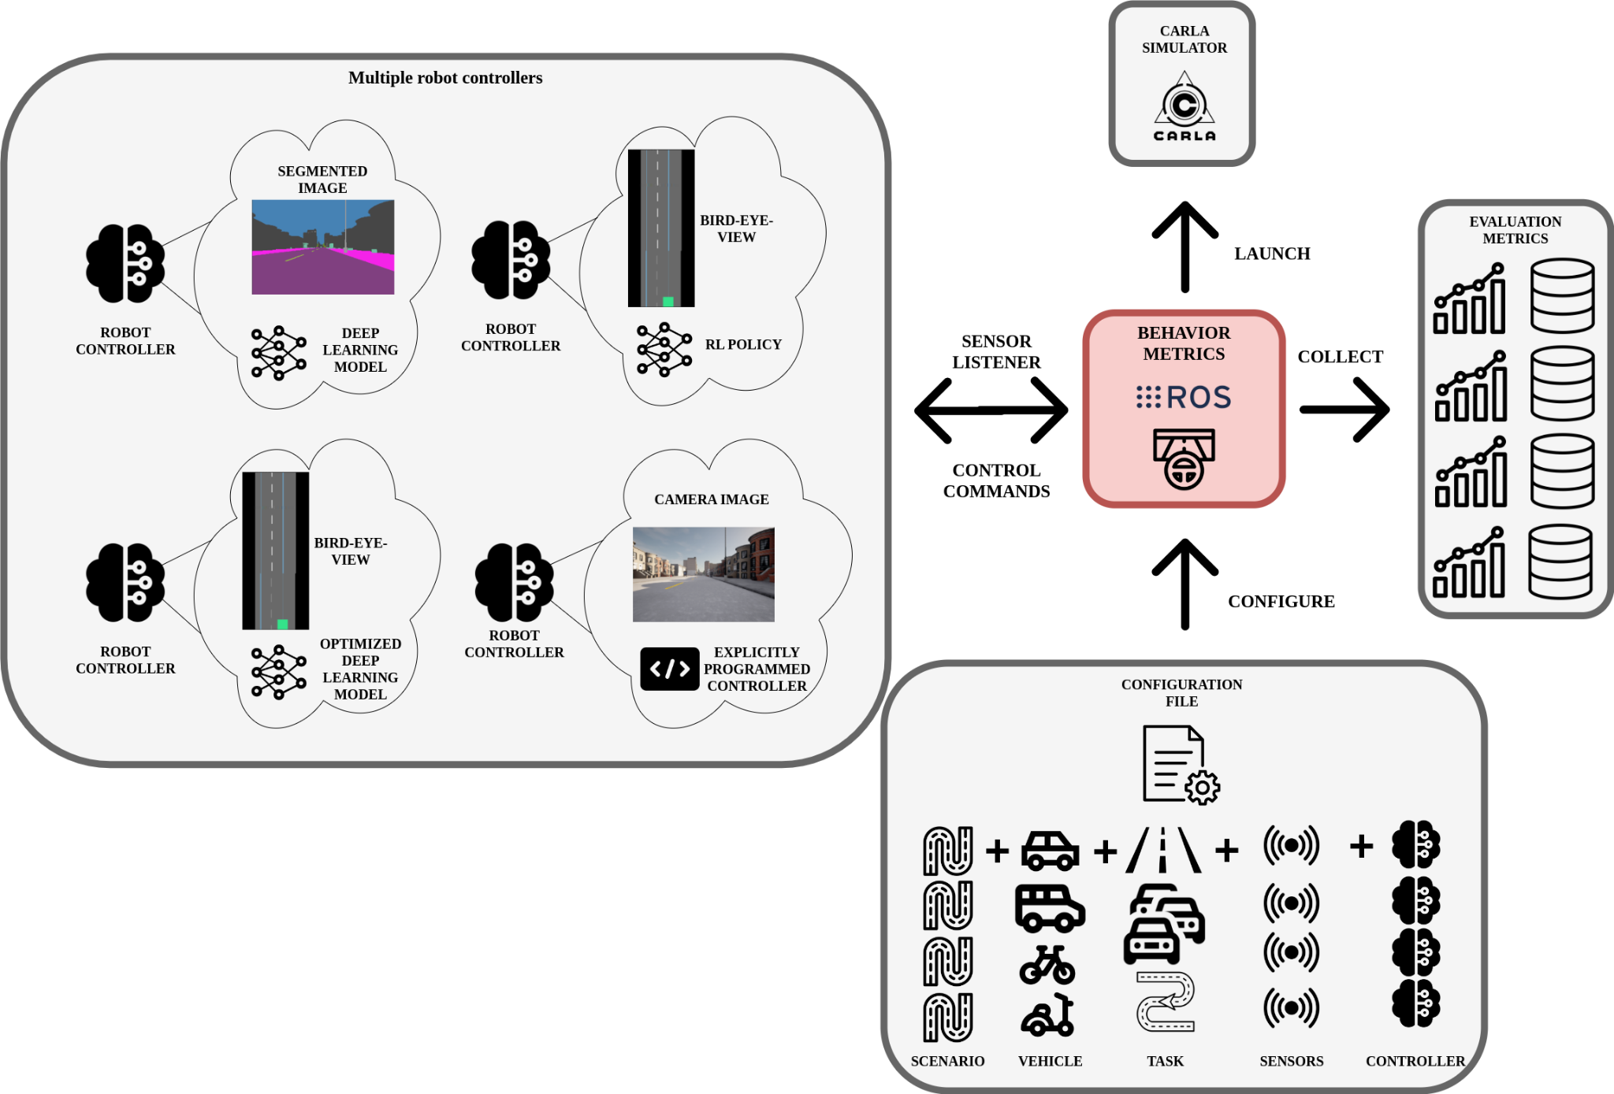
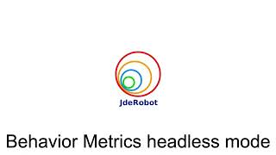
Headless evaluation mode

Slide 55
Autonomous driving evaluation metrics
The proposed metrics are complementary to the simulator metrics (CARLA Leaderboard) and specific for each particular task:
Mean position deviation per km.
Effectively completed distance.
Vehicle longitudinal jerk per km (add formulas).
Robot controller iteration frequency.
GPU inference frequency.
Collisions per km
Lane invasions per km.
Distance to the front vehicle
…

Slide 56
Impact and conclusions
Used as an assessment tool in this thesis.
There is a need for specialized assessment tool in autonomous driving for easy extraction of conclusions from experiments.
Behavior Metrics is open-source.

Slide 58
Enhancing e2e AD control through kinematic input and memory-based architectures
We explore and compare various approaches to enhance the capabilities of an en-to-end system for autonomous driving based on imitation learning adding visual memory and kinematic data input.
The comparison relies on fundamental error metrics (MAE, MSE) and several external complementary fine-grain metrics based on the behavior of the ego vehicle at several test scenarios in the CARLA simulator.
S. Paniego, R. Calvo-Palomino, and J. M. Cañas, “Enhancing End-to-End Control in Autonomous Driving through Kinematic-Infused and Visual Memory Imitation Learning,” Manuscript submitted for publication, 2024.

Slide 59
Enhancing e2e AD control through kinematic input and memory-based architectures
The problem focuses on the lane-following application using different urban scenario layouts and visual bird-eye-view input.
The memory addition covers architectural modifications and different types of sensory input.
We show experimentally that incorporating visual memory capabilities and kinematic input data makes the system more robust and able to handle a wider range of challenging situations in terms of reduction of collisions and speed self-regulation.
All the work is open-source.

Slide 60
Introduction
We introduce and compare several DL architectural modifications that incorporate memory models and different sensory inputs to explore the potential benefits of different memory approaches in solving the problem of end-to-end AD through imitation learning.
We also explore the inclusion of kinematic data as input.
The research hypothesis is that adding visual memory capabilities and kinematic input data improves the quality of the generated robot control behavior in terms of the system’s robustness for never-seen situations and speed self-regulation.

Slide 61
Kinematic-infused and visual memory E2E control based on imitation learning
We have 8 DL architectures based on an E2E approach.
We use the segmented bird-eye-view as input.
CARLA for training and testing.
The dataset is obtained from an expert driving in the scenarios (train vs test scenarios).
4 different DL architectures are explored:
One without memory.
Three with visual memory.
We also explore the addition of the kinematic input data (current speed) as input.
PilotNet as baseline (Bojarski et al. 2016).

Slide 62
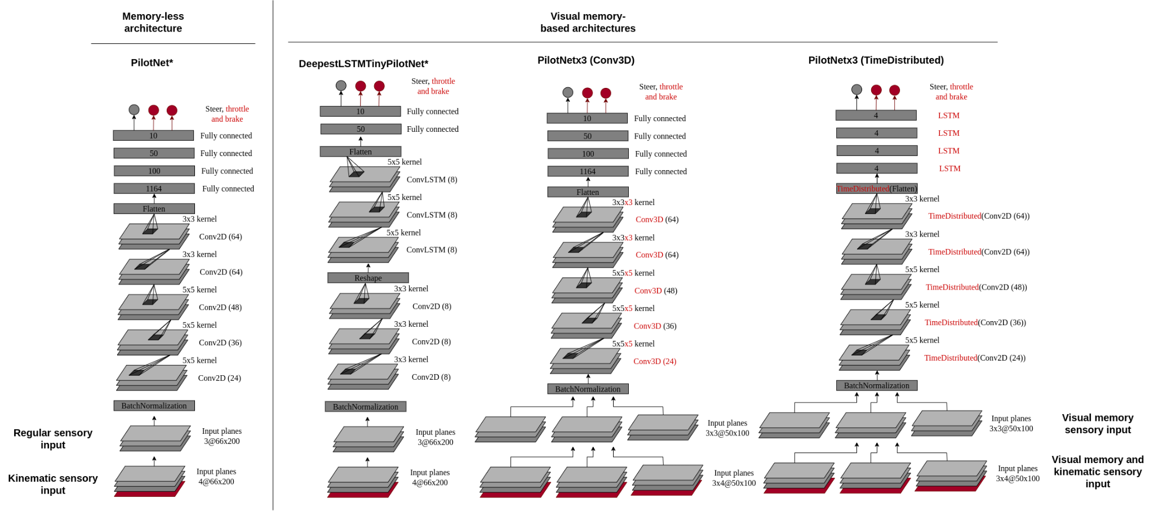
Kinematic-infused and visual memory E2E control based on imitation learning

Slide 63
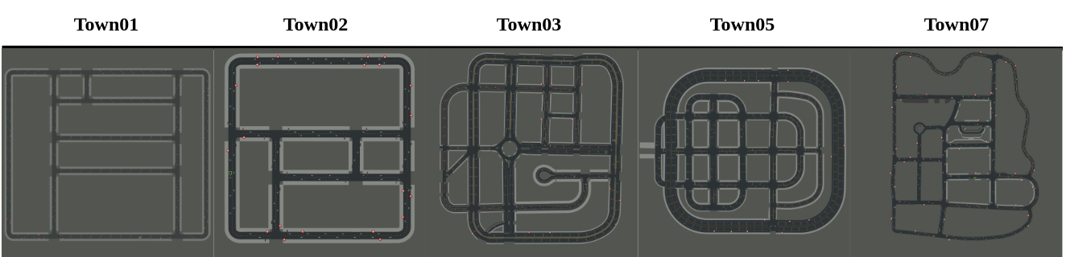
Kinematic-infused and visual memory E2E control based on imitation learning

Slide 64
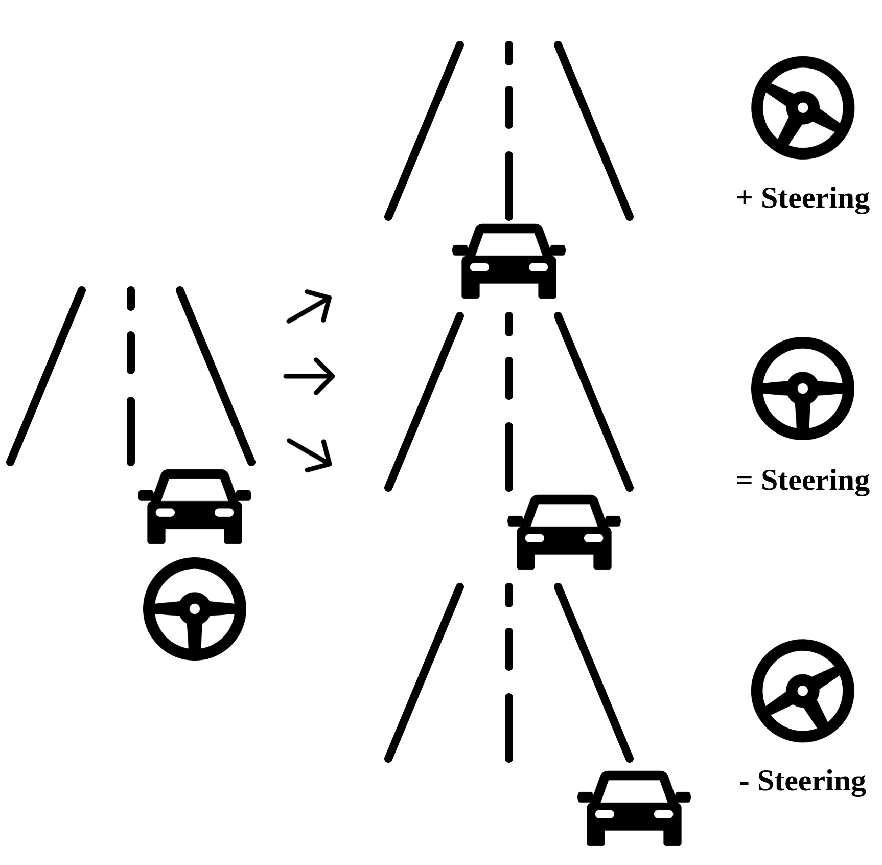
Kinematic-infused and visual memory E2E control based on imitation learning
Training:
20Hz for the collection.
Data augmentation. Affine is key.

Slide 65
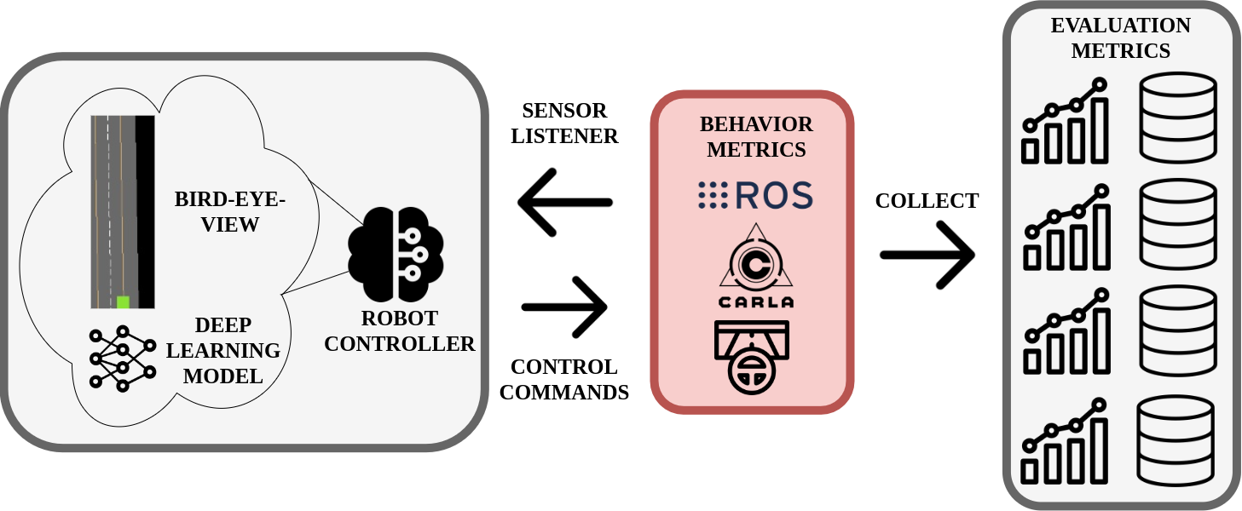
Measuring e2e imitation learning for robot control
In addition to the common metrics using in ML (MAE, MSE), we evaluate them with Behavior Metrics.

Slide 66
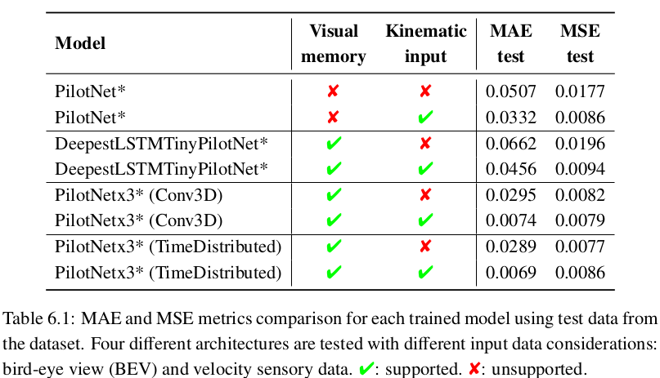
Experiment 1
Comparison of models using common ML metrics:

Slide 67
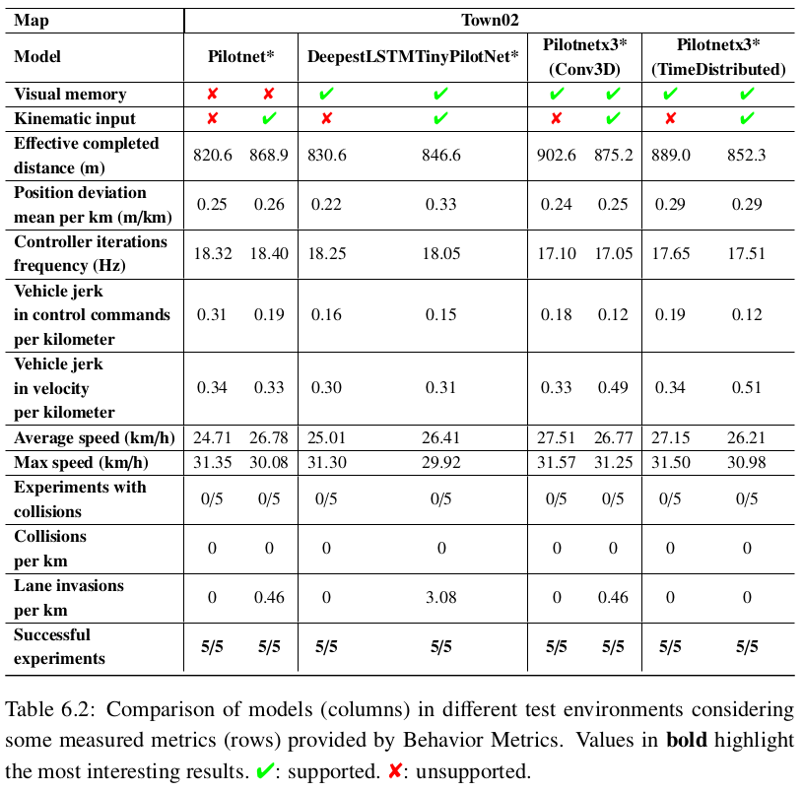
Experiment 2
Behavior in test scenario with top speed regulation

Slide 68
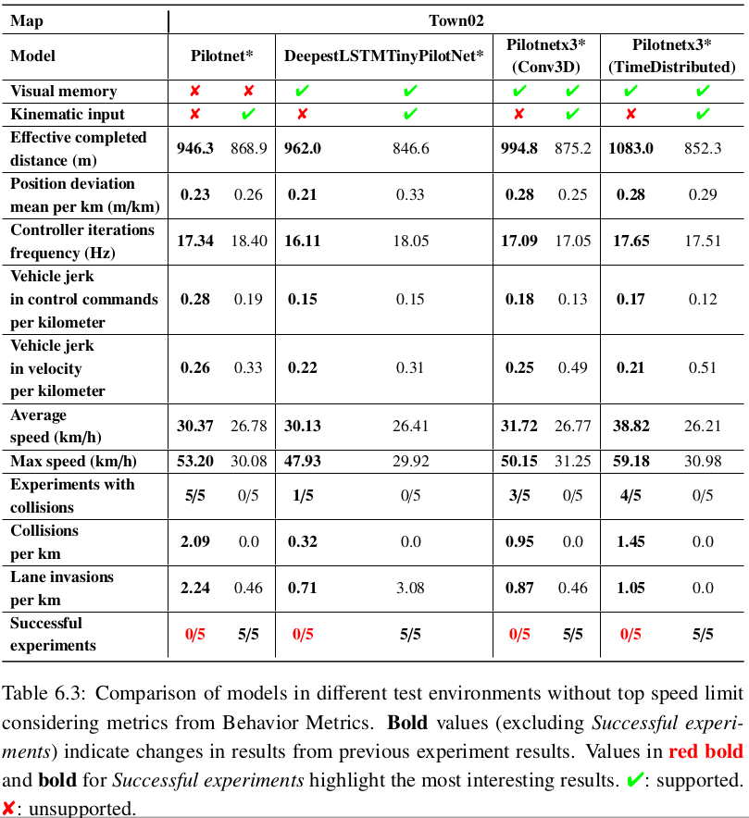
Experiment 3
Behavior in test scenario without top speed regulation

Slide 69
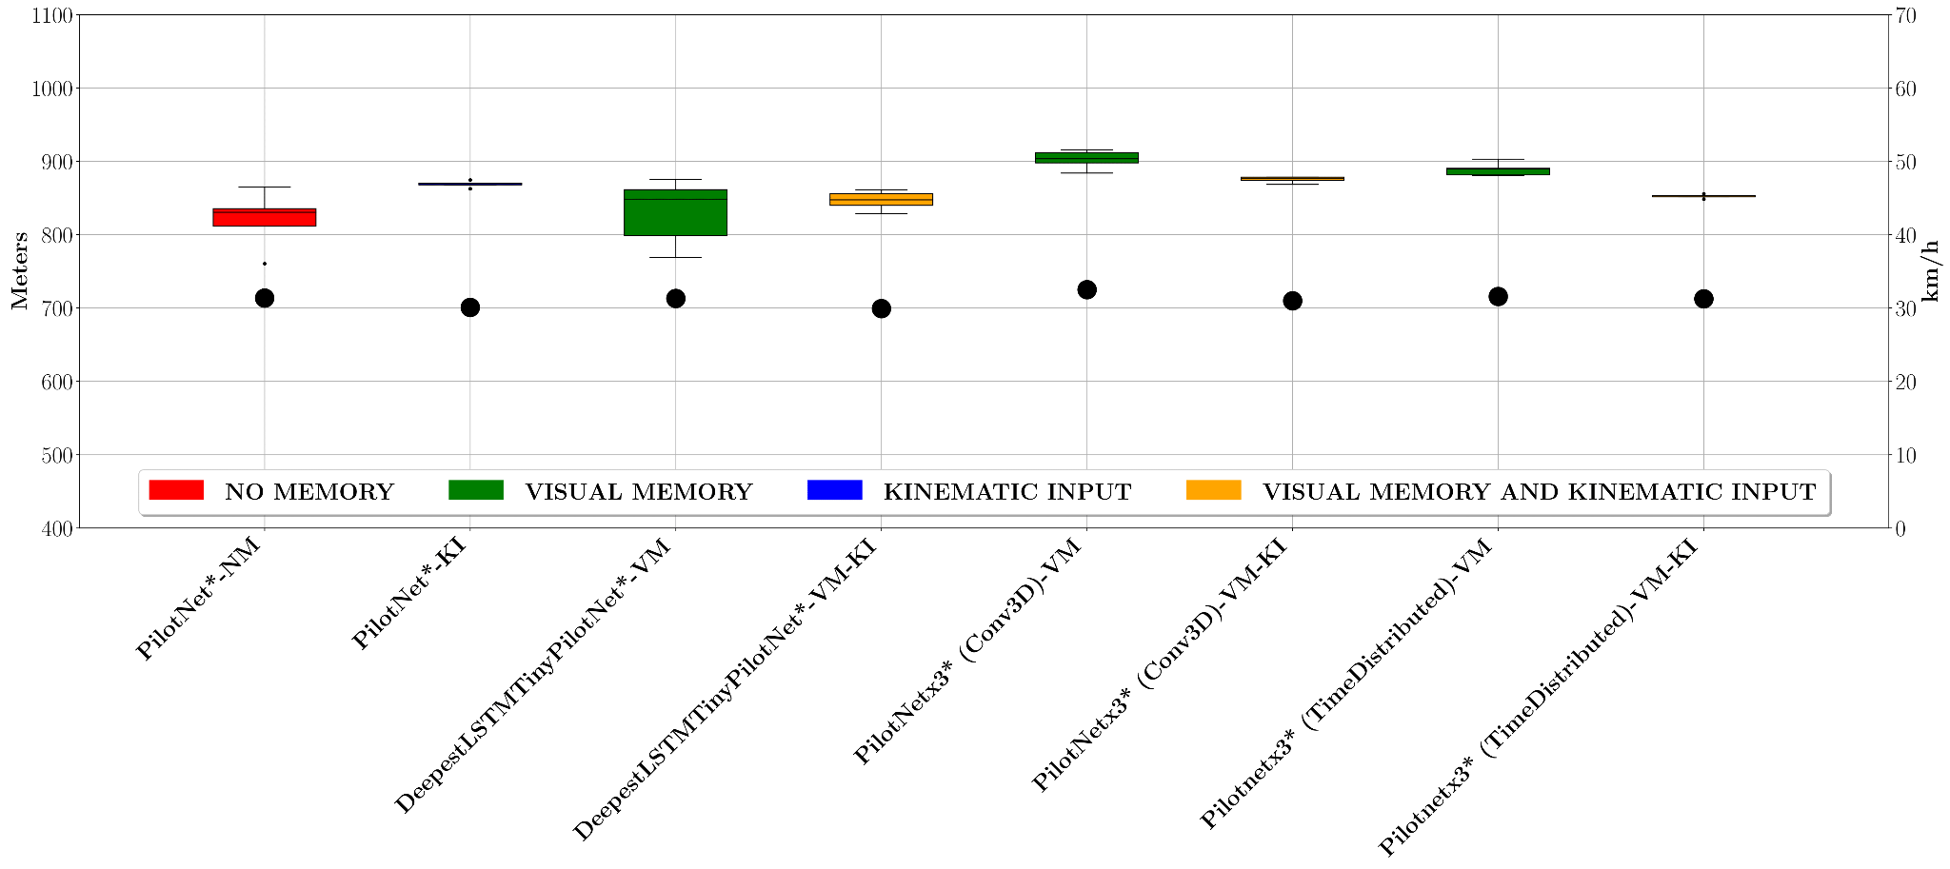

Experiment 2 and 3

Slide 70



Experiment 4
Taking the control of a fast-moving car

Slide 71




Experiment 5
Robustness to sensory manipulation

Slide 72


Experiment 6
Visual memory and density comparison

Slide 73

Experiments summary

Slide 74
Conclusions
We studied four different architectures and a variation of each one for e2e robot control based on imitation learning for an autonomous driving problem.
We proved that adding visual memory and kinematic input data to the models enhances the quality of the final control behavior for following the lane.
Adding kinematic data, the system controls the speed better.
Combining it with visual memory, the vehicle increases its range of application.

Slide 76

Optimization of end-to-end autonomous driving control
We explore and compare a variety of alternatives for model optimization in the context of e2e imitation learning autonomous driving.
Performance depends on quality of decisions and their frequency. Increase frequency without sacrificing decision quality.
Run deep learning robot-control application even in limited computed hardware.
Open source materials.
S. Paniego, N. Paliwal, and J. Cañas, “Model optimization in deep learning based robot control for autonomous driving,” IEEE Robotics and Automation Letters and IEEE International Conference on Robotics and Automation (ICRA), vol. 9, no. 1, pp. 715–722, 2024. doi: 10.1109/LRA.2023.3336244. [Online]. Available: https://doi.org/10.1109/LRA.2023.3336244

Slide 77



Optimization of end-to-end autonomous driving control
Trend towards e2e solutions.
DL models are high-demanding.
Available computing hardware is key for performance.
Some autonomous robots have high-performant hardware while others do not and is not always possible to upgrade (edge devices).
Optimization solution (framework support).

Slide 78

Optimizing e2e IL models for lane-follow robot control
The baseline architecture is based on PilotNet (Bojarski et al. 2016), named PilotNet*.

Slide 79
Optimizing e2e IL models for lane-follow robot control
Optimizations used:
Quantization (float16, int8).
Pruning.
Fine tuning (retraining).
Clustering.

Slide 80

Assessment of Models
Behavior Metrics (Paniego et al. 2024).
In addition to the simulator's metrics:
Controller frequency.
GPU inference frequency.
Position deviation mean per km.
Successful runs.

Slide 81
Experiment 1: Offline evaluation
Model size reduction (12x int8 quantization).
GPU inference frequency improves.
135x TensorRT int8 quantization.
50x framework-specific int8 quantization.
Similar MSE.
Combination of optimizations generates best case: PCQAT (Sparsity and cluster preserving quantization aware training).

Slide 82

Experiment 2: Online evaluation
Higher controller frequency.
Faster models: int8 (47x TF, 2.3x PyTorch).
Similar mean position deviation and average speed.
Previous insights are applicable.
No decision quality degradation in online evaluation.
Faster and smaller models.
TF and PyTorch similar. TensorRT best.
Optimization limits require tuning.

Slide 83

Experiment 3: Inference freq. and Quality of Decisions in Robot Control Performance
Quality changes when the frequency of decisions is changed in the robot control.
Optimizing benefits control quality since in limited hardware, it may be critical to generate decisions above the turning point.

Slide 84
Conclusions
Optimizations improve the system performance (controller speed-up without losing decision quality).
Offline and online evaluation.
Optimized models have wider range of application (edge devices).
Combination of optimizations and hardware-specific optimizations generate the best models.

Slide 86
End-to-end vision-based autonomous driving in traffic
A shallow e2e vision-based DL approach for autonomous driving in traffic scenarios.
Goals: follow the lane and maintain a safe distance from possible preceding vehicles.
We prioritize simplicity of the model.
S. Paniego, E. Sinohara, and J. M. Cañas, “Autonomous Driving in Traffic with End-to-End Vision-based Deep Learning,” Neurocomputing, 2024. doi: 10.1016/j.neucom.2024.127874. [Online]. Available: https://www.sciencedirect.com/science/article/pii/S0925231224006453

Slide 87

Imitation learning for driving in traffic
Dataset extracted from expert agent behavior.
Traffic-0: does not consider traffic.
Traffic-1: includes one type of front vehicle
Traffic-6: includes 5 other vehicles including vans and three urban cars of different sizes and colors

Slide 88

Imitation learning for driving in traffic
2 models are variations of PilotNet (PilotNet* and PilotNet**)
We include oversampling during training.

Slide 89

End-to-end vision-based autonomous driving in traffic
We utilize activation heatmaps to understand where the models is paying attention during the decision making (Grad-CAM).

Slide 90

Experimental setup
We use Behavior Metrics for the online evaluation, including new specialized metrics (distance to vehicle)
With small changes to the architecture of PilotNet, it is possible to expand its application area widely.

Slide 91

Experiment 1: Execution without traffic
All the combinations of model+dataset works correctly. The model trained with Traffic-6 is better in MPD and Lane invasions.

Slide 92


Experiment 2: Execution with traffic
The model trained with Traffic-6 is better for all the metrics.

Slide 93


Experiment 3: generalization
The model trained with Traffic-6 generalizes for a whole set of vehicles

Slide 94

End-to-end vision-based autonomous driving in traffic

Slide 95
Conclusions
Proposal for safe autonomous driving in traffic scenarios following and e2e vision-based approach with imitation learning and deep learning.
The shallow models slightly changed can drive in traffic situations successfully as proved experimentally.
We also include a new metrics to Behavior Metrics.
TFM co-direction.

Slide 97
Conclusions and future research
Comprehensive literature review.
Solution for vehicle monitoring using deep learning.
Massive and unattended automatic assessment of DL visual object detection models solution.
Open source tool for the online assessment of autonomous driving systems.
Beyond achieving the basic follow lane, we explore the implications of the addition of visual memory and kinematic data to some apparently simple DL architectures.

Slide 98
Conclusions and future research
Study the possibilities that optimization of DL add to the performance of the model and how they affect the final behavior.
Proposal for safe driving in traffic scenarios following an e2e vision-based approach with imitation learning and deep learning.

Slide 99
Research contributions
5 journal and conference papers:
S. Paniego, R. Calvo-Palomino, and J. Cañas, "Behavior Metrics: An Open-Source Assessment Tool for Autonomous Driving Tasks," Software X, vol. 26, pp. 101702, 2024 doi: 10.1016/j.softx.2024.101702. [Online]. Available: https://doi.org/10.1016/j.softx.2024.101702 [239]
S. Paniego, N. Paliwal, and J. Cañas, “Model optimization in deep learning based robot control for autonomous driving,” IEEE Robotics and Automation Letters and IEEE International Conference on Robotics and Automation (ICRA), vol. 9, no. 1, pp. 715–722, 2024. doi: 10.1109/LRA.2023.3336244. [Online]. Available: https://doi.org/10.1109/LRA.2023.3336244 [244]
S. Paniego, V. Sharma, and J. M. Cañas, “Open source assessment of deep learning visual object detection,” Sensors, vol. 22, no. 12, 2022. doi: 10.3390/s22124575. [Online]. Available: https://www.mdpi.com/1424-8220/22/12/4575 [234]
J. Fernández, J. M. Cañas, V. Fernández, and S. Paniego, “Robust real-time traffic surveillance with deep learning,” Computational Intelligence and Neuroscience, vol. 2021, p. 4 632 353, Dec. 2021. doi: 10.1155/2021/4632353. [Online]. Available: https://doi.org/10.1155/2021/4632353 [224]
S. Paniego, E. Sinohara, and J. M. Cañas, “Autonomous Driving in Traffic with End-to-End Vision-based Deep Learning,” Neurocomputing, 2024. doi: 10.1016/j.neucom.2024.127874. [Online]. Available: https://www.sciencedirect.com/science/article/pii/S0925231224006453

Slide 100
Research contributions
1 manuscript under peer-review
Sergio Paniego, Roberto Calvo-Palomino, and José María Cañas, “Enhancing End-to-End Control in Autonomous Driving through Kinematic-Infused and Visual Memory Imitation Learning”.
1 preprint:
S. P. Blanco, S. Mahna, U. A. Mishra, and J. Canas, Memory based neural networks for end-to-end autonomous driving, 2022. arXiv: 2205.12124 [cs.RO]. [256]
1 workshop paper
P. F. de Cabo, R. Lucas, I. Arranz, S. Paniego, and J. M. Cañas, “RL-studio: A tool for reinforcement learning methods in robotics,” in ROBOT2022: Fifth Iberian Robotics Conference, Springer International Publishing, Nov. 2022, pp. 502–513.doi: 10.1007/978-3-031-21062-4_41. [Online]. Available: https:// doi.org/10.1007%2F978-3-031-21062-4_41. [257]

Slide 101


Future work 1
Point-to-point e2e navigation using input commands.
GSoC project.

Slide 102



Future work 2
Transferring current e2e solutions to a real-world vehicle.

Slide 103
Future work 3
E2e autonomous driving modulated with text-based instructions. LLMs
GSoC project.

Slide 104

Future work 4
Exploration of e2e autonomous driving in aerial vehicles.

Slide 105

Future work 5
Exploration of e2e autonomous driving in unstructured environments.
TFM co-direction.

Slide 106
Future work 6 and 7
Exploration of RL approaches for e2e autonomous driving.
Combination of driving experts.
TFG co-direction

Slide 108
End-to-end Vision-based Autonomous Driving using Deep Learning
Sergio Paniego Blanco
@sergiopaniego
sergio.paniego@urjc.es
https://sergiopaniego.github.io/
https://roboticslaburjc.github.io/
Escuela de Ingeniería de Fuenlabrada Teoría de la Señal y las Comunicaciones y Sistemas Telemáticos y Computación

Slide 111
End-to-end Vision-based Autonomous Driving using Deep Learning
Author
Sergio Paniego Blanco
Supervisor
José María Cañas Plaza
Doctoral Program in Information and Communications Technologies
International Doctoral School
2024
@sergiopaniego
sergio.paniego@urjc.es
https://sergiopaniego.github.io/

Slide 112
Curso de Inteligencia Artificial
Sergio Paniego Blanco
@sergiopaniego
sergio.paniego@urjc.es
https://sergiopaniego.github.io/
https://roboticslaburjc.github.io/
Escuela de Ingeniería de Fuenlabrada Teoría de la Señal y las Comunicaciones y Sistemas Telemáticos y Computación

Slide 113
Outline
Introducción a Python.

Slide 114

Web
https://roboticslaburjc.github.io/

